Slide 1
Stable Care
Notes:
This section introduces the participants to the basics of looking after a stable kept horse. Topics covered include: types of bedding, providing water and a basic skipping out procedure
Ask the group to come up with some reasons why horses are kept in stables
If they have seen horses in stables did they notice what the horse was standing on?

Slide 2
Types of Bedding
Notes:
Discuss as a group any reasons they can think of why bedding is used
What types of bedding are the group familiar with? Can they identify the bedding in the pictures?
Discuss each type, write a description in the booklets and list some pros and cons of each. Banks could be discussed here or in the skipping out section.
There is a welfare bedding leaflet available to download. www.bhs.org.uk/wealfareleaflet for further information

Slide 3
Water
Notes:
Link water back to welfare needs in earlier slides. How much water can an average horse drink per day? (30-70litres/53-123pints)
Discuss ways of supplying water in the stable – water buckets/drinkers.
Why do they need to be changed regularly?
Safety – why movable handles should be positioned against the wall

Slide 4
Skipping out
Notes:
Discuss as a group reasons for keeping a stable clean. Participants to write reasons in booklet

Slide 5
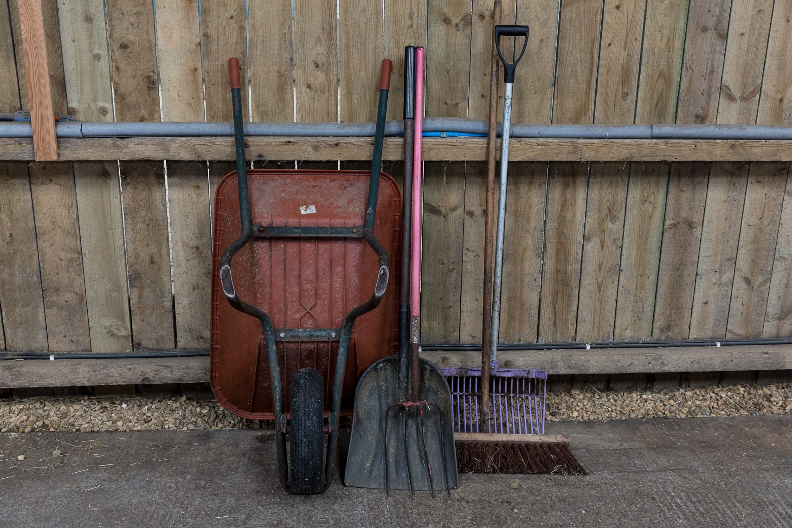
Tools required
Notes:
Fork suitable for bedding type – what are the differences between shavings and straw fork
Skip bucket or wheel barrow
Broom
Shovel or scoop

Slide 6
Skipping out
Notes:
Talk through a procedure for skipping out.
Highlight aims: remove droppings but not clean bedding, reshape bed, reshape banks (talk about use of banks here if not mentioned before), sweep bed back from door, reasons for cleaning water buckets/drinkers each time. What to do with muck

Slide 7
Quick quiz
Name two types of bedding suitable for horses
Name two methods of providing water to horses in stables
List three reasons for keeping a stable clean
List the tools you might need to skip out
What do you need to make sure of when you remove droppings?
Notes:
This quiz is very informal and is not designed to be a test. Answers can be written or verbal and there is space for the participants to write answers in their booklet.
Suggested answers:
shavings, straw, flax, wood pellets, carboard, paper or any other acceptable answer
Buckets, drinker, tub
Reduce risk of disease/illness, keep bed clean, reduce waste bedding, pleasant environment or other acceptable answer
Fork, skip, barrow, shovel, broom, poo skip and fork or any other acceptable answer
Sieve the bedding, don’t remove too much bedding

