Slide 1
Horse Health
Challenge Award
Notes:
This presentation is the outline of the ailments and illnesses covered in the Horse Health booklet.
It is designed so you can expand on each slide or follow what is written in the booklet. If you are delivering this in conjunction with your vet, they may wish to add their own images/text to the slides.
Ideally the bandaging will be covered in a practical session to allow participants to practice these skills but the principles can be covered in a theory session.

Slide 2
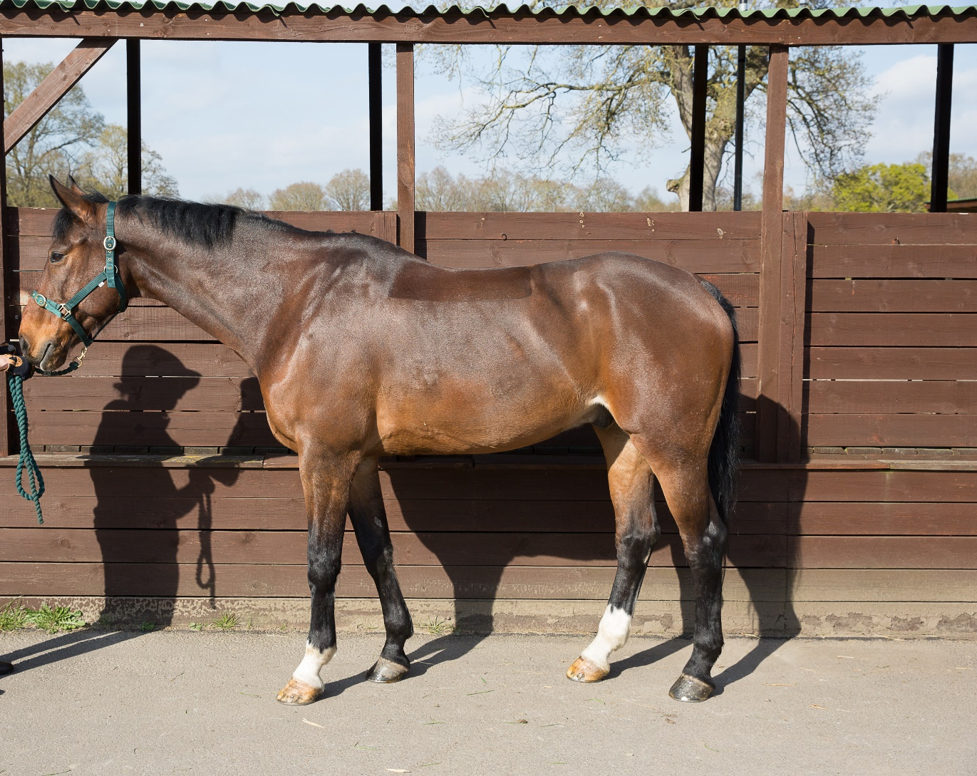
Routine Checks
Notes:
Discuss what routine checks are and why they should form part of your daily routine
Discuss what general checks to make.
What do people check with their own horses?
Does anyone keep health records for their horse? What sort of thing do they record?
Point for discussion:
Details of what to do in an emergency and you cannot be contacted e.g. would you want your horse to have colic surgery? What information should you give your livery yard owner/manager. As a manager/owner what information do you ask your liveries to give you?

Slide 3
Taking TPR
Normal Guidelines for horses:
Temperature
37.5-38.3⁰C (99.5 – 101.5⁰F)
Respiration
8-16 breaths per minute
Pulse
28-44 beats per minute
Notes:
Discuss normal rates
Why should horse owners know this?
What order should you take them?

Slide 4
Temperature
Tie your horse up
Switch on thermometer and put some petroleum jelly on tip
Stand to the side of your horse’s quarters and gently move the tail out of the way
Carefully insert the thermometer in to the anus and gently press it against the wall of the rectum
Hold the thermometer there until it beeps and then gently remove it
Read the result and thoroughly clean the thermometer

Slide 5
Pulse
Put a headcollar on your horse and tie him up
Stand to the side where you can see his flanks rising and falling
A rise and fall counts as one breath
Count the number over a period of 30 seconds and multiple this by 2 to get the number per minute

Slide 6
Pulse
Put headcollar on your horse and tie him up
Stand next to his left shoulder
Place stethoscope behind the left elbow
You are listening for a ‘lub-dub’ sound
Each ‘lub-dub’ is a beat
Count the number for 15seconds and multiply by 4 to get the number of breaths per minute
Notes:
Can also include how to check for pulse at the jaw bone or digital pulse in fetlock (laminitis)

Slide 7
When to call the vet
Reasons include:
Heavy bleeding
Wounds over a joint (especially if it is a puncture wound)
Large wounds anywhere on the body or if any structures under the skin are visible such as bone, tendon or ligaments
Not able to put any weight on a limb
Injuries to the eye or eyelid
Signs of colic
Any sudden extreme changes in behaviour such as staggering
If the horse has collapsed and cannot get up
If the horse is stuck
If the horse is struggling to breathe
If the horse is not able to or is straining to pass urine
Signs of heat exhaustion
Embedded object for example a nail has gone into the sole of the hoof
Signs of laminitis
Notes:
Discuss as group reasons when the vet should be called
Create a list and add to the one given in the booklet (also on slide)

Slide 8
Wounds
How to stop bleeding
Types of wound
  Puncture
  Bruise
  Open
  Graze
Methods of cleaning a wound
Notes:
Discuss ways of stopping bleeding and what to do if it won’t stop
How to differentiate between types of wound
How wounds heal
How to clean a superficial wound
What to do if waiting for the vet

Slide 9
Limb and hoof conditions
Abscess
Nail prick
Nail bind
Thrush
Laminitis
Tendon injuries
Splints
Windgalls
Lymphangitis
Lymphedema
Notes:
This list is what is covered in the booklet, you may want to add more to it.
Each heading has a Brief description, What to look for and What to do.
You may wish to follow this format or create your own.

Slide 10
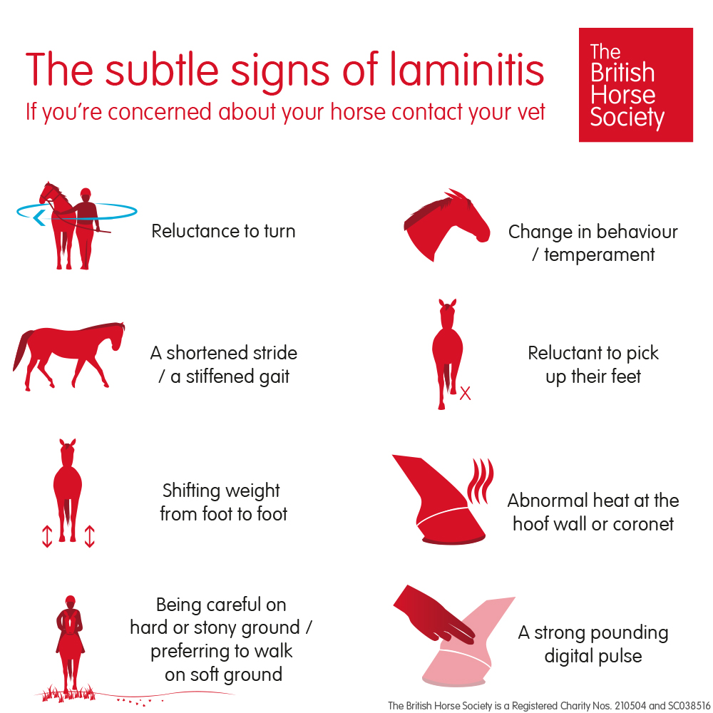
Laminitis

Slide 11
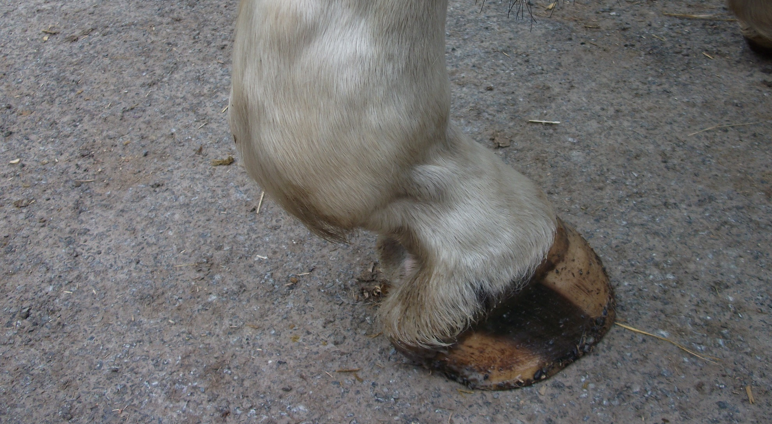
Windgalls

Slide 12
Horse Health
Choke
Nosebleeds
Discharge from nostrils
Eye conditions
Strangles
Equine Influenza
Tetanus
Equine Asthma/Recurrent Airway Obstruction (RAO)
Notes:
This list is what is covered in the booklet, you may want to add more to it.
Each heading has a Brief description, What to look for and What to do.
You may wish to follow this format or create your own.

Slide 13
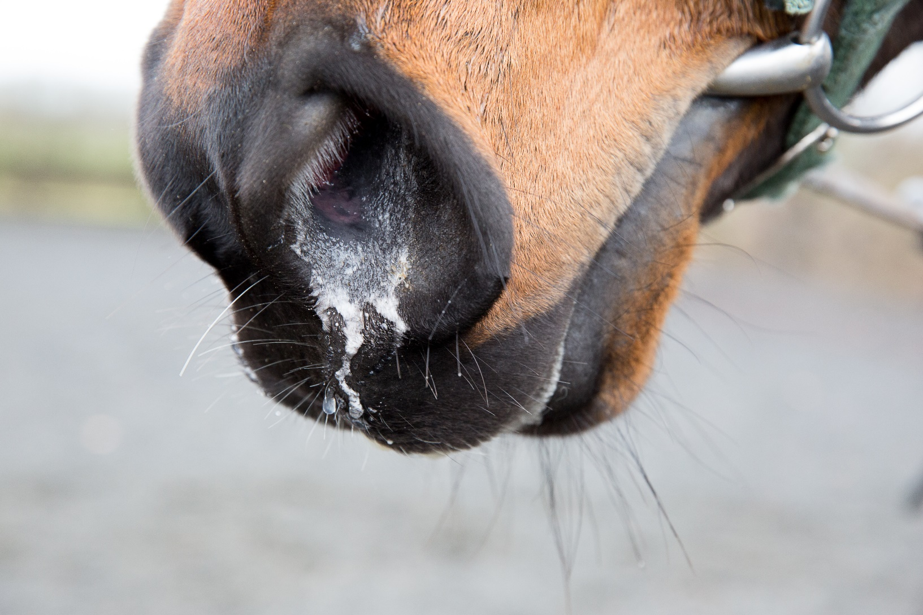
Discharge from nostrils

Slide 14
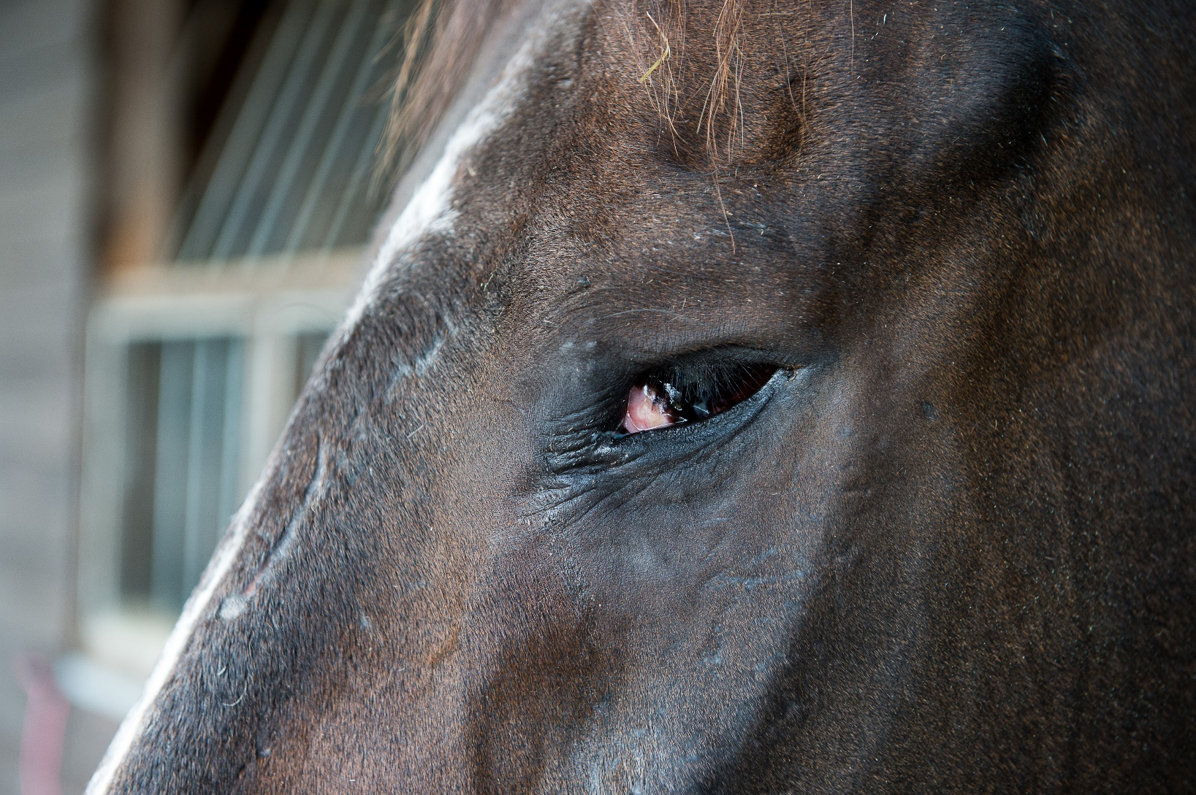
Eye conditions

Slide 15
Teeth
Signs horse not comfortable:
  Quidding
  Long fibre/undigested food in droppings
  Weight loss
  Resistance or evasion of bit
  Facial Swellings
  Change in behaviour
  Discharge from nostrils
  Pouching of food in cheeks
  No Pain? Check Again! An Equine Dental Health project

Slide 16
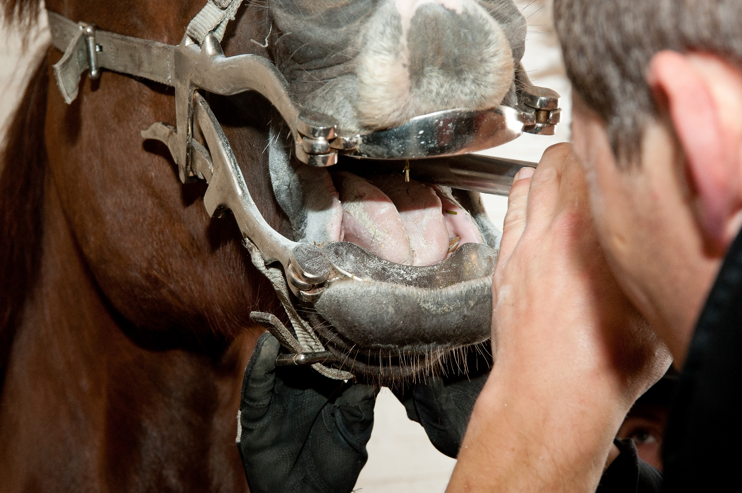
Teeth rasping

Slide 17
Horse Health
Urticaria
Ringworm
Equine Pastern Dermatitis
Rain scald
Sweet itch
Notes:
This list is what is covered in the booklet, you may want to add more to it.
Each heading has a Brief description, What to look for and What to do.
You may wish to follow this format or create your own.

Slide 18
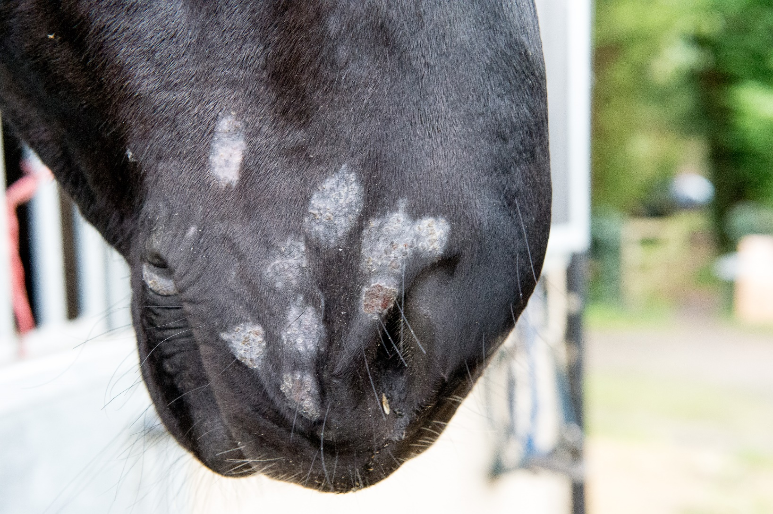
Ringworm

Slide 19
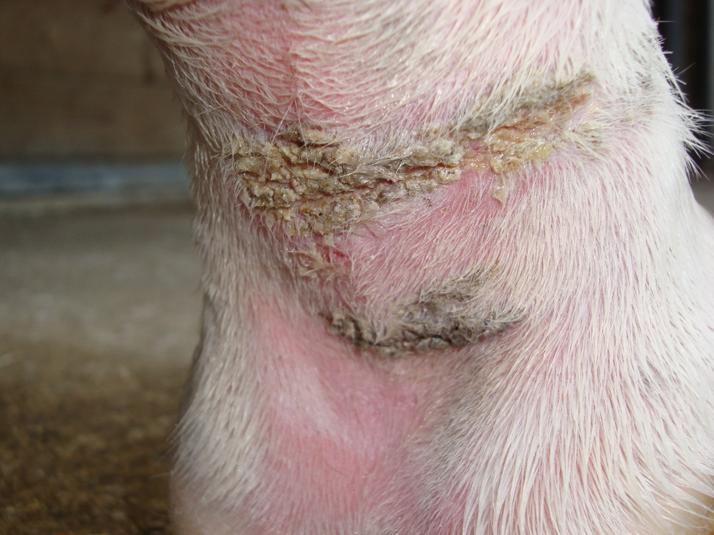
Equine Pastern Dermatitis

Slide 20
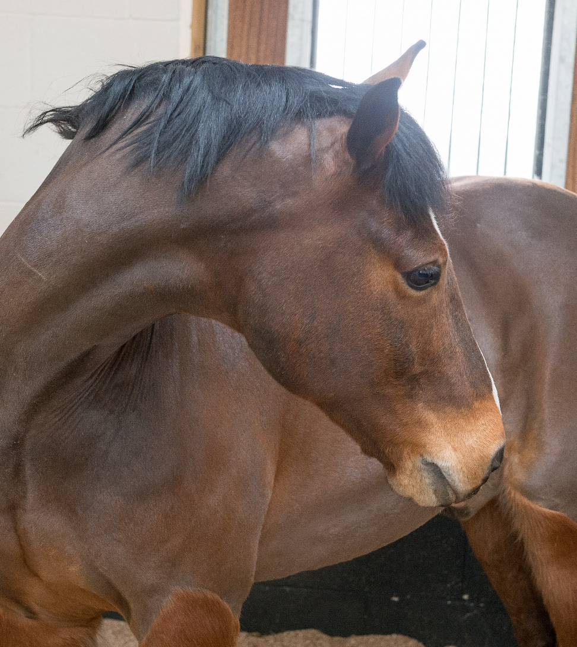
Horse Health
Colic
React Colic pack
Notes:
Colic the link should take you to the BHS website where there is lots more information about Colic and the research that has been carried out. Colic React Packs can be ordered from the BHS Welfare Department.

Slide 21

Colic

Slide 22
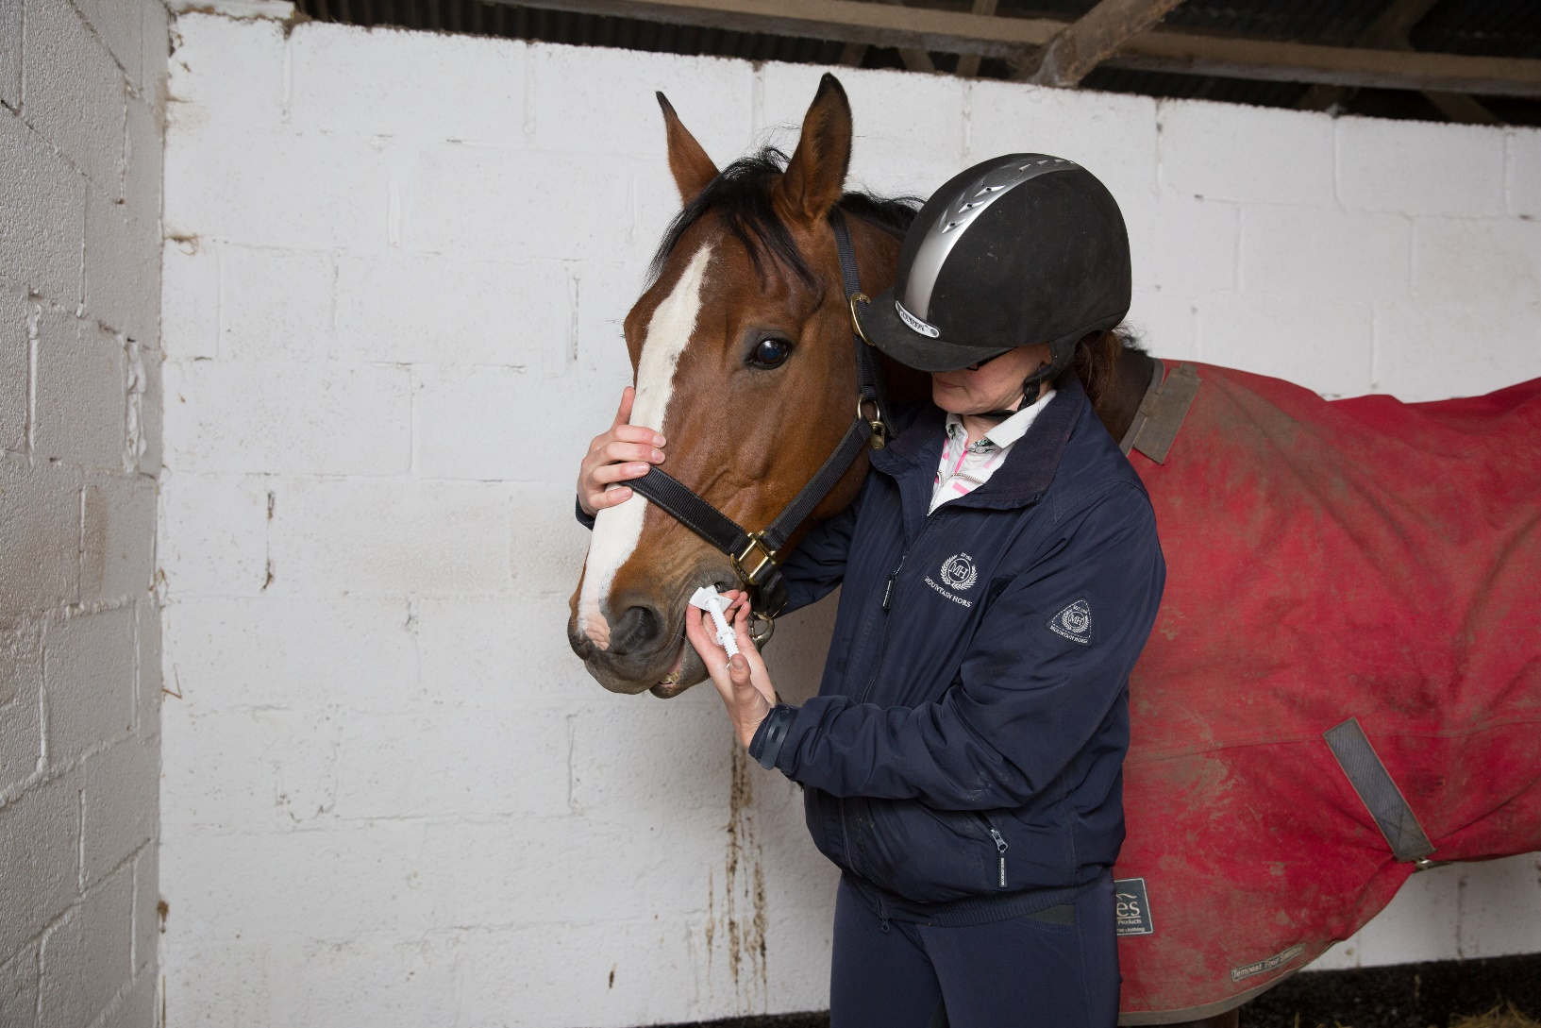
Worming
Notes:
Worming
Signs of worm burden
Methods of worm control
Testing for worm burden
How to worm your horse – calculating doses and why being accurate is important

Slide 23
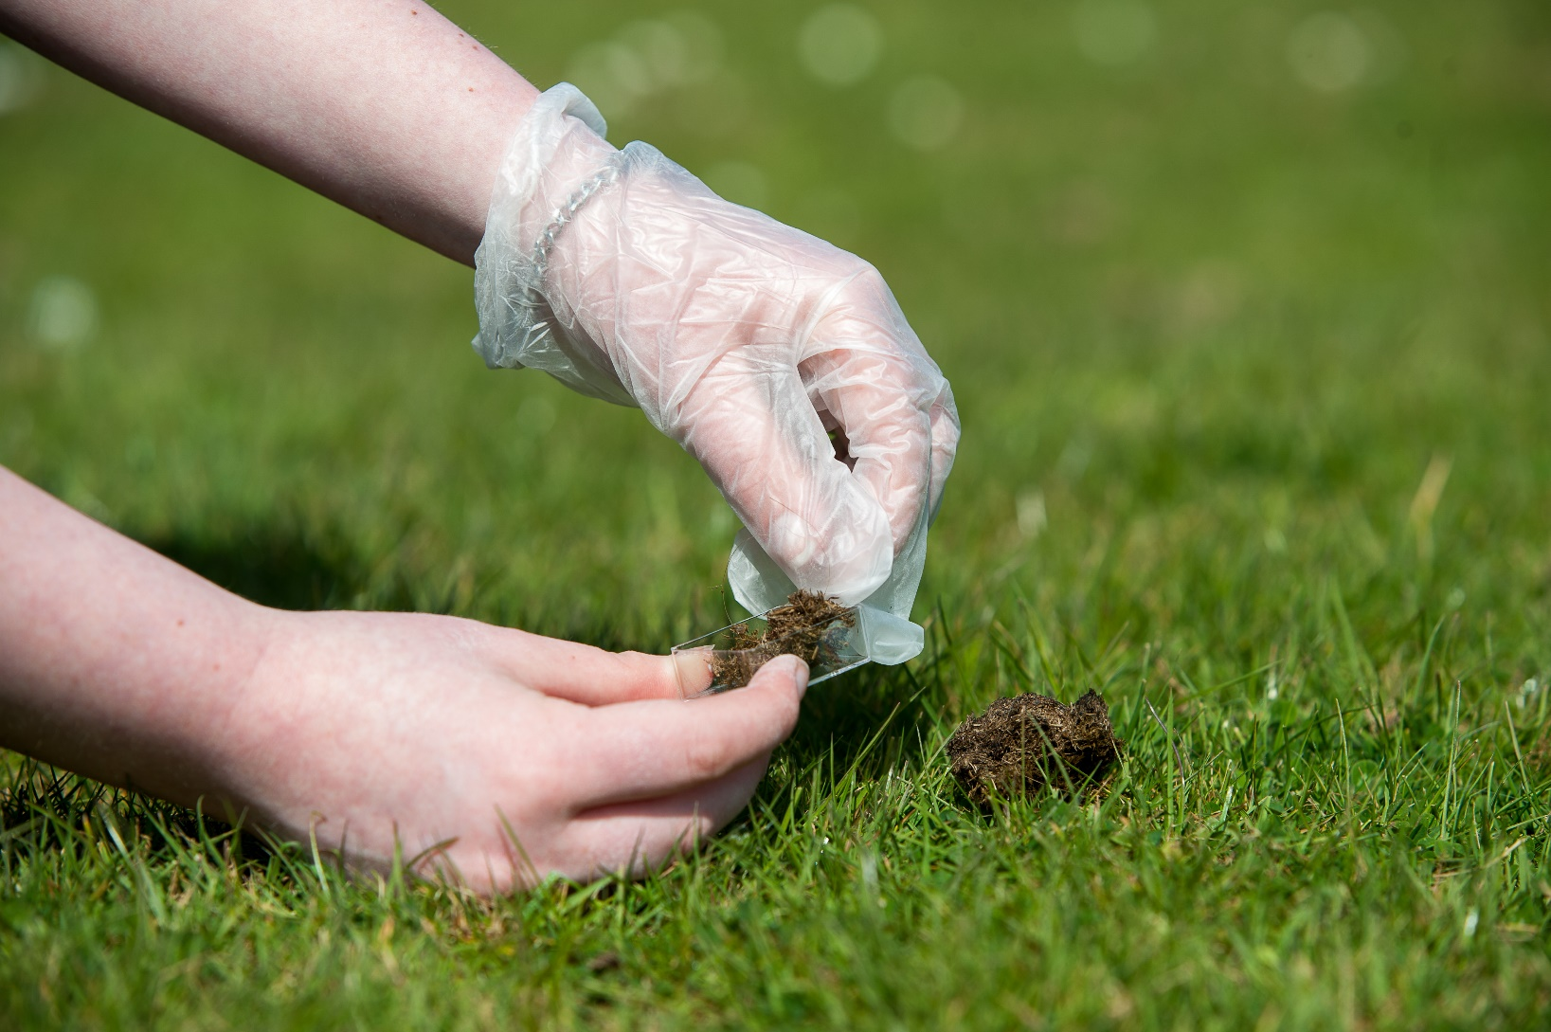
Worm Egg Counts

Slide 24
Horse Health
Pituitary pars Intermedia Dysfunction (PPID)
Equine Gastric Ulcer Syndrome (EGUS)
Equine Metabolic Syndrome (EMS)
Exertional Rhabdomylosis Syndrome (ERS)
Equine Seasonal Myopathy (ESM)
Heat Exhaustion
Dehydration
Notes:
This list is what is covered in the booklet, you may want to add more to it.
Each heading has a Brief description, What to look for and What to do.
You may wish to follow this format or create your own.

Slide 25
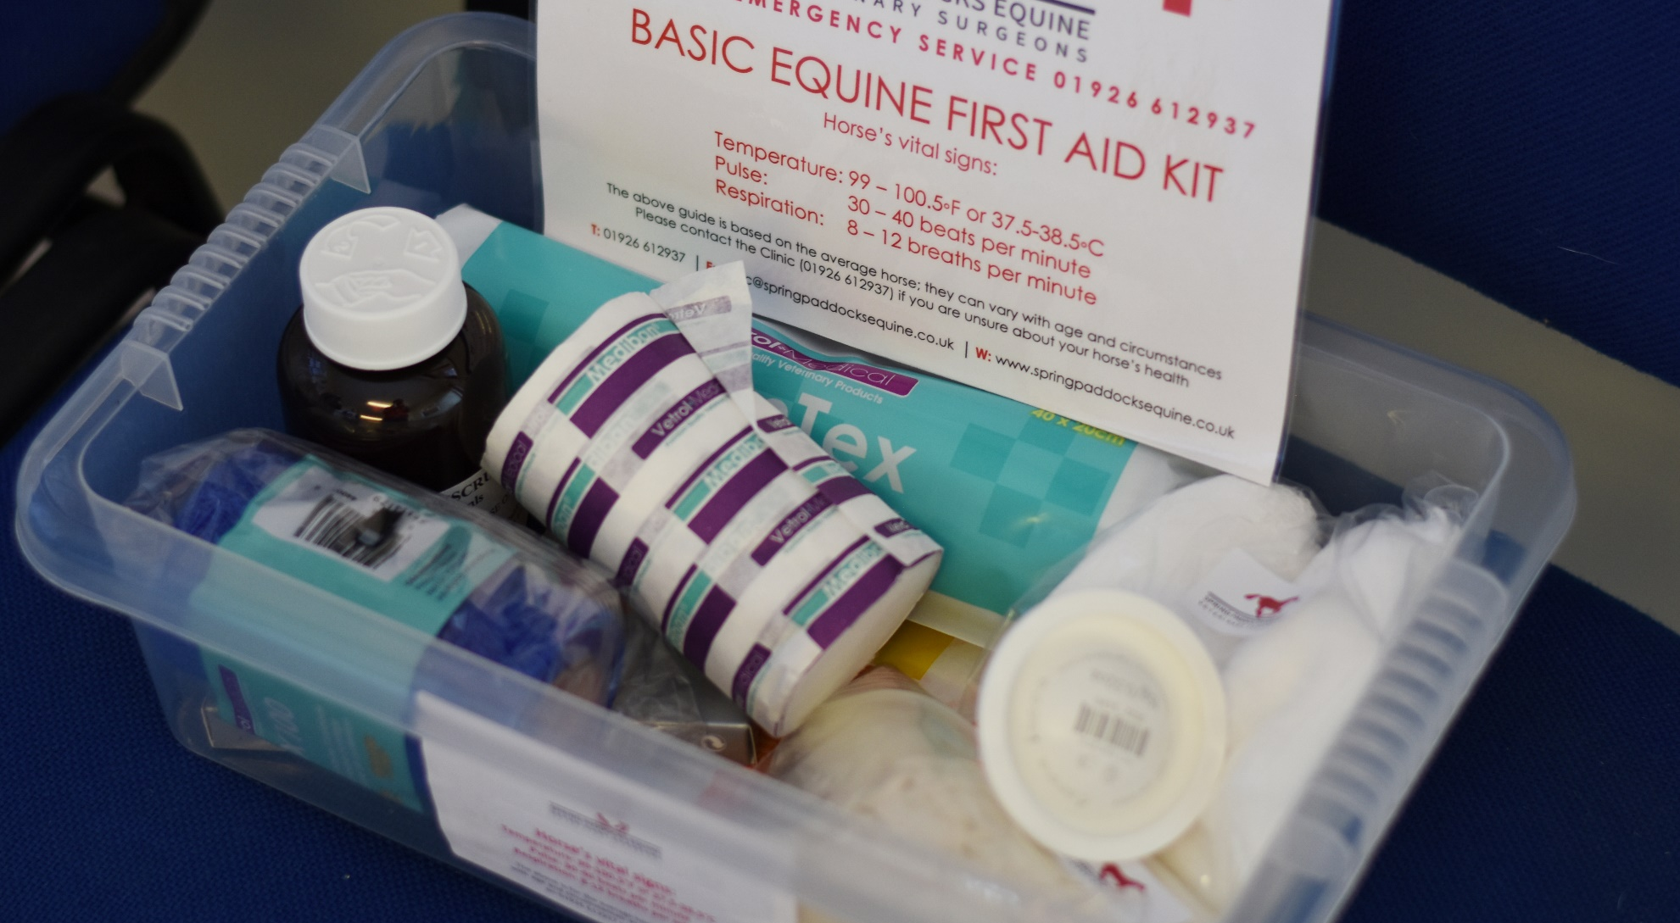
First Aid Kit
Notes:
Suggested contents

Slide 26
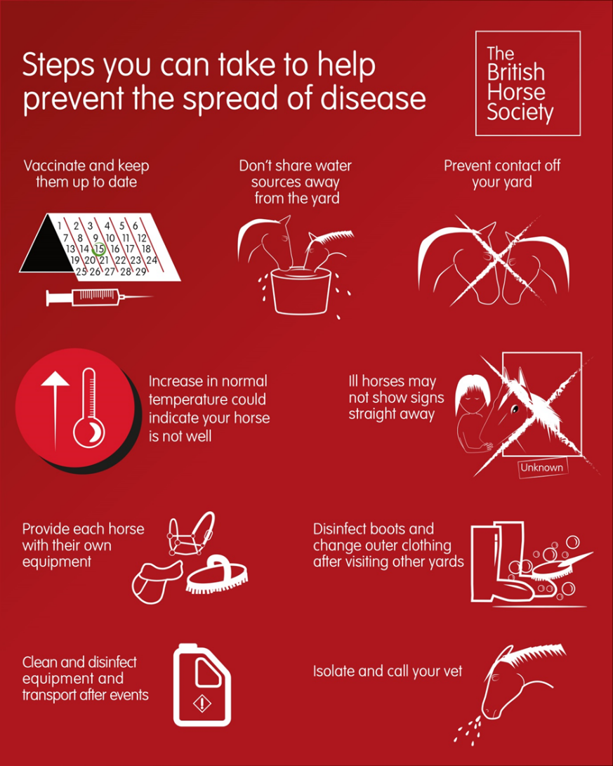
Disease Prevention

Slide 27
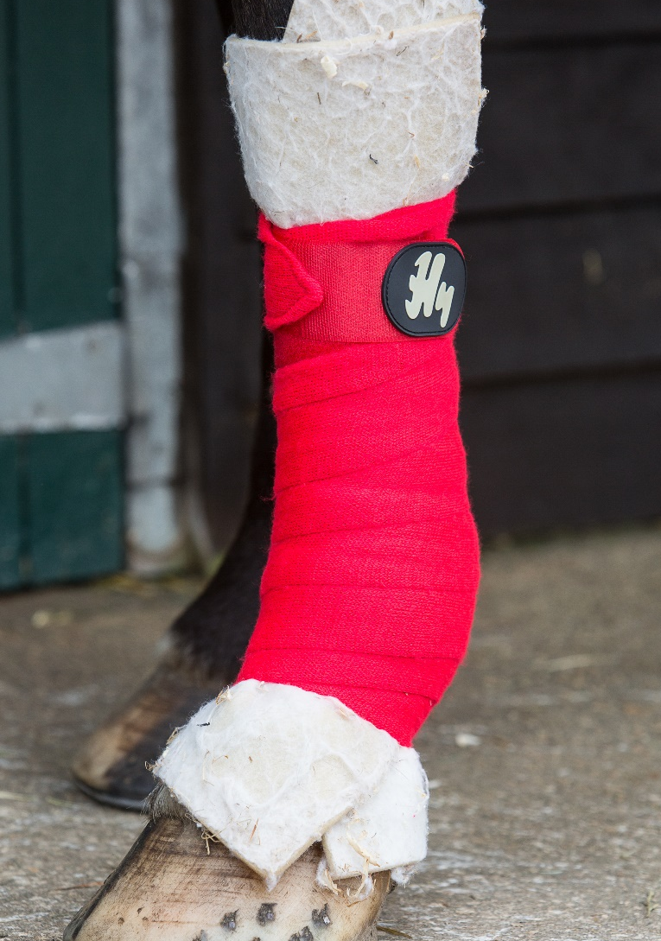
Basic Treatments and procedures
Stable Bandages
1.Wrap the padding around the leg so the overlap is facing the back of your horse
2.Holding the padding in place start your bandage half way down the cannon bone, unrolling the
bandage from the front to the back of the leg
3.Take care to avoid any wrinkles or folds in the padding or bandage which will create pressure points on the leg
4.Continue down the leg with each layer overlapping the previous one by roughly half
5.Wrap the bandage under the fetlock and work your way back up the leg stopping below the knee or hock (if the bandage is very long you may need to continue back down the leg again)
6.Check the tension at the top and bottom of the bandage
Notes:
Discuss the use of stable bandages
What type of padding can go underneath?
Alternatives to stable bandages
Method to applying stable bandages
Dangers of a badly applied banadage

Slide 28
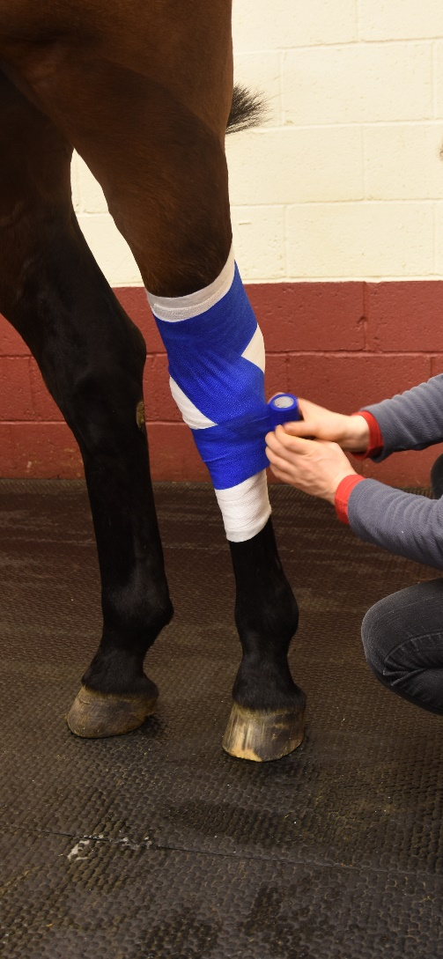
Figure of eight bandage
Start above the joint
Wrap the bandage around the leg, from front to back, several times to secure it
Take the bandage diagonally across the front of the joint
Wrap the bandage around the cannon bone below the joint to secure it, taking care not to cover any protruding bones at the back of the knee or at the side of the hock
Take the bandage diagonally back across the joint to the top
Repeat this figure of eight movement until the bandage is secure

Slide 29
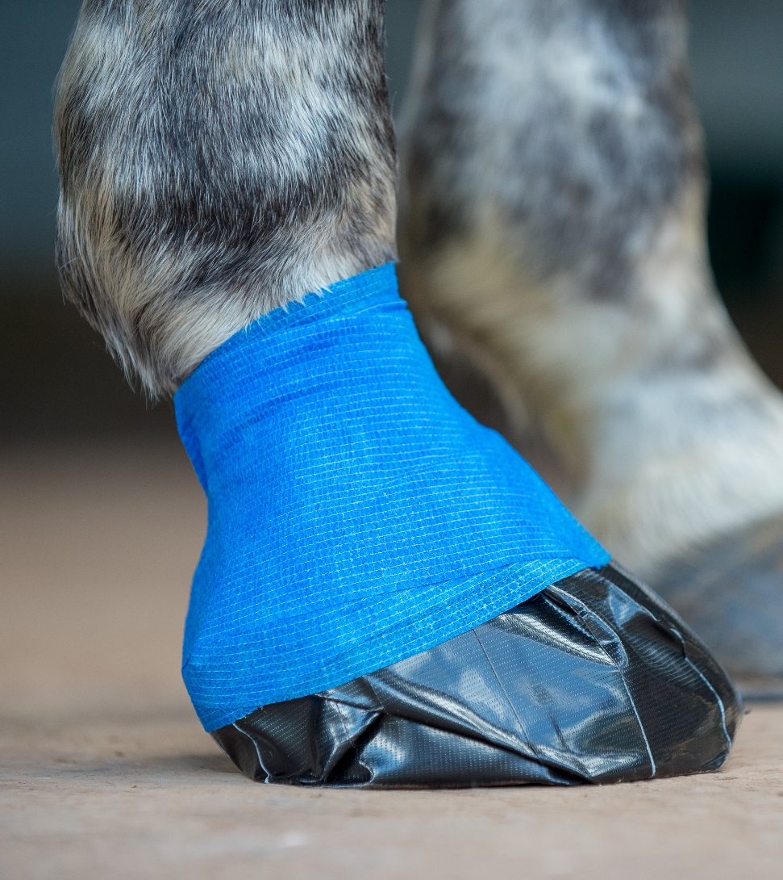
Hoof poultice
Tie your horse up on a clean, dry surface or ask someone to hold him for you
Hold the foot up as if you were removing a shoe to leave both hands free
Clean the foot thoroughly to remove any mud or debris
Apply the poultice placing it with the shiny side facing upwards and place the layer of plastic over it
Wrap enough self -adhesive bandage around the whole hoof to keep the pad in place
Wrap the tape on top of the bandage to help keep it place
Notes:
Discuss the use of a poultice
Equipment required to prepare (wet and dry)
Methods of applying and keeping one on!
Hoof boots

Slide 30
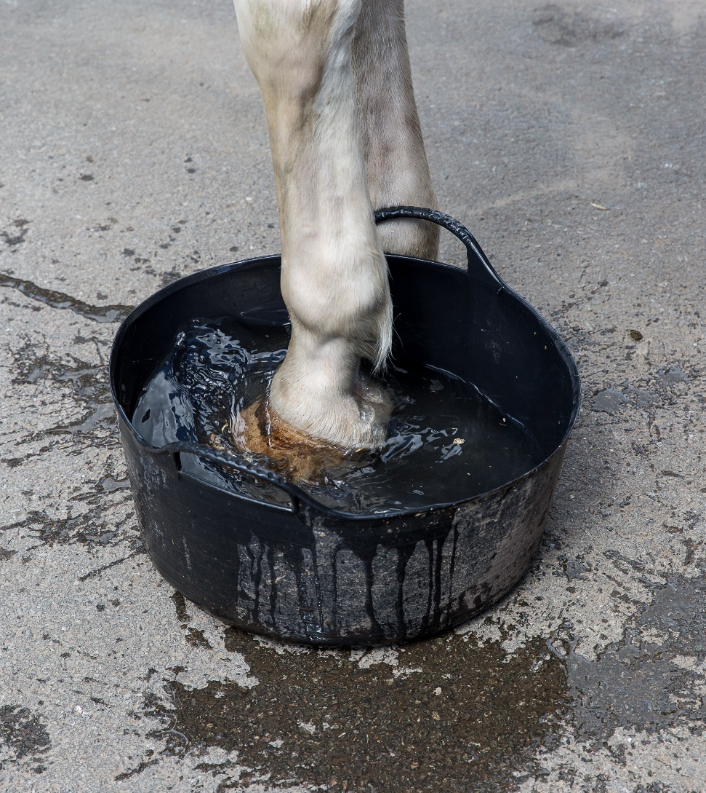
Tubbing
Collect the equipment you need
Ask someone to hold your horse or cross tie him somewhere safe
Pick out the foot and scrub it clean
Position the bucket and place your horse’s foot in
Add the water and check the depth of the water
Add Epsom salts as required to create a sludge in the bottom of the bucket

Slide 31
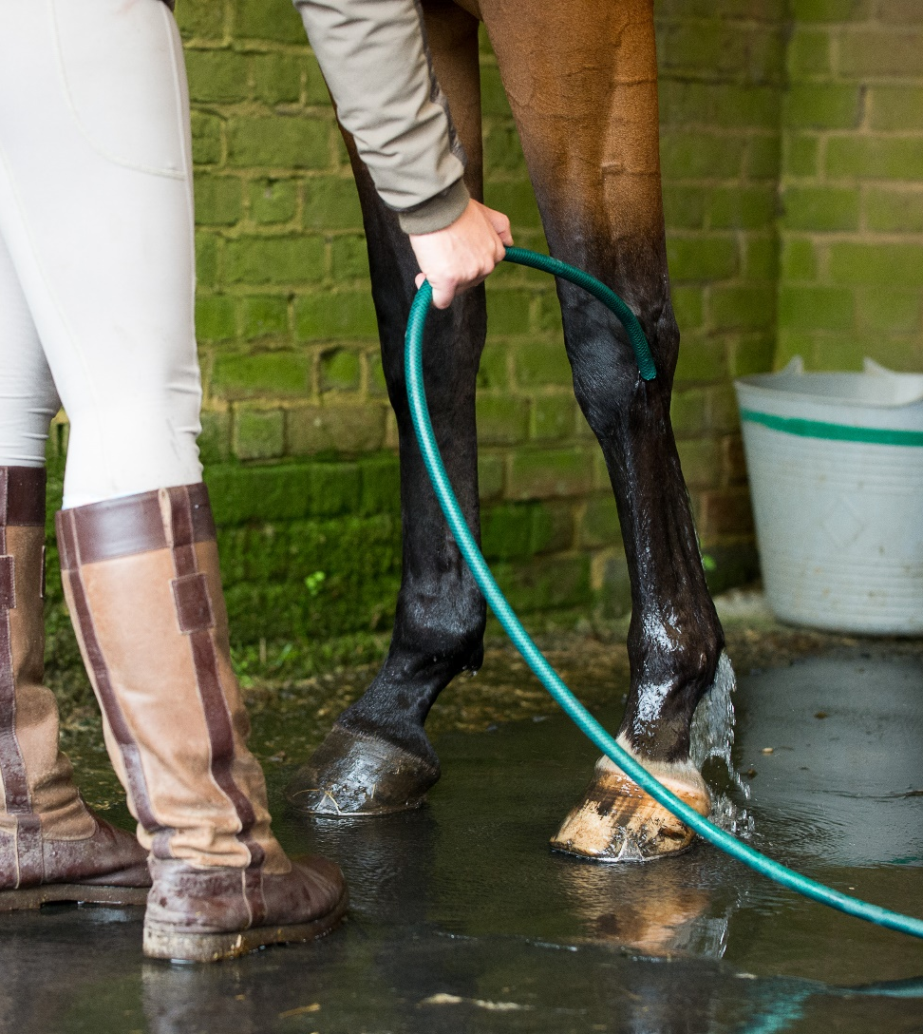
Cold Hosing
Hold your horse
Turn the hose on to a slow trickle and start at the hoof
Slowly work your way up allowing the horse to get used to the feeling of the water
Aim the flow of water slightly above the swelling
Increase the pressure slightly to a steady flow
Your vet will advise you on how long to cold hose for but it will usually be between five to ten minutes

Slide 32
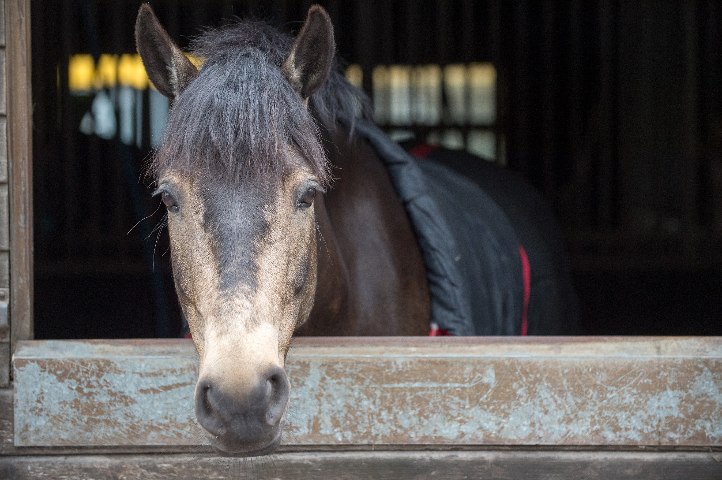
Box rest
Notes:
What is meant by box rest
Possible reasons for it
How to look after a horse on box rest
Ideas for keeping them occupied

