Slide 1
Horse Knowledge
Part Two
Notes:
Add coach name to the text box
The slides are grouped by topic and can be delivered in any order
There are optional notes giving ideas for session plans or activities to go along with each presentation
There are optional handouts available to download from the BHS Cloud

Slide 2
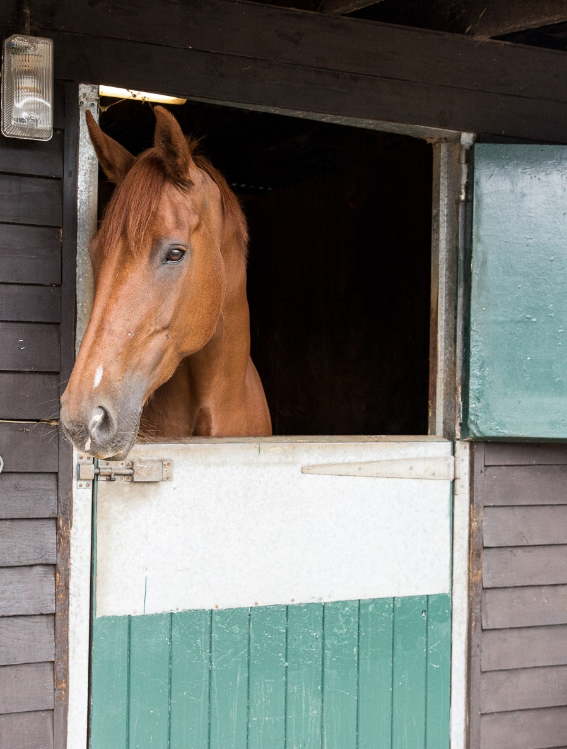
Introduction
Welcome
Housekeeping
Structure of course
Notes:
Welcome group and explain the structure of the course. The content covered is on the next slide
Any housekeeping such as location of fire exits, toilets, tea/coffee provisions

Slide 3
Basic Horse Knowledge part two
Content
Horse behaviour
Passports and microchips
Signs of good health
Disease prevention
Feeding
Field checks
Poisonous plants
Parts of the saddle and bridle
Notes:
Outline the main topics covered within the course. These are broken down further at the start of each section.
The slides have been grouped in topics that follow the layout of the booklet but can be delivered in any order.

Slide 4
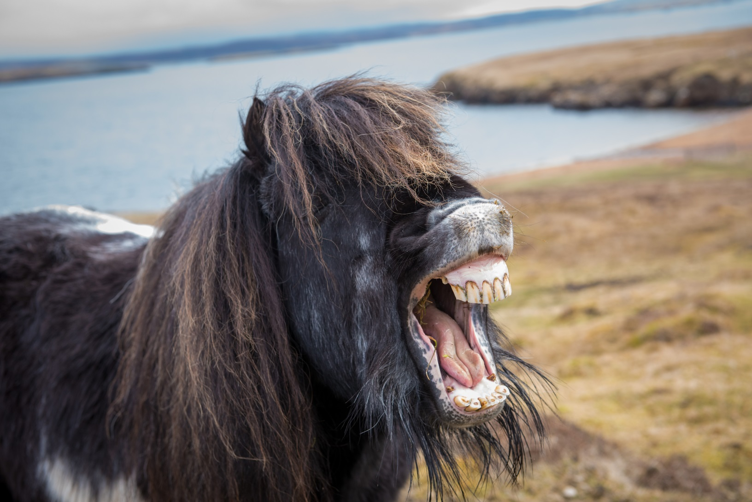
Horse Knowledge
Horse Behaviour
Notes:
This section introduces how to recognise facial expressions and reactions of the horse. Link it back to yard safety from part one

Slide 5
Body language
Why is it important to understand horse’s body language and facial expressions?
Notes:
Discuss with the group why it is important to know about horse behaviour
Discuss how horse’s communicate with each other and with us. Can the group give any examples of communication behaviour they have seen?
Discuss how the horse communicates with us, ask the group for their examples

Slide 6
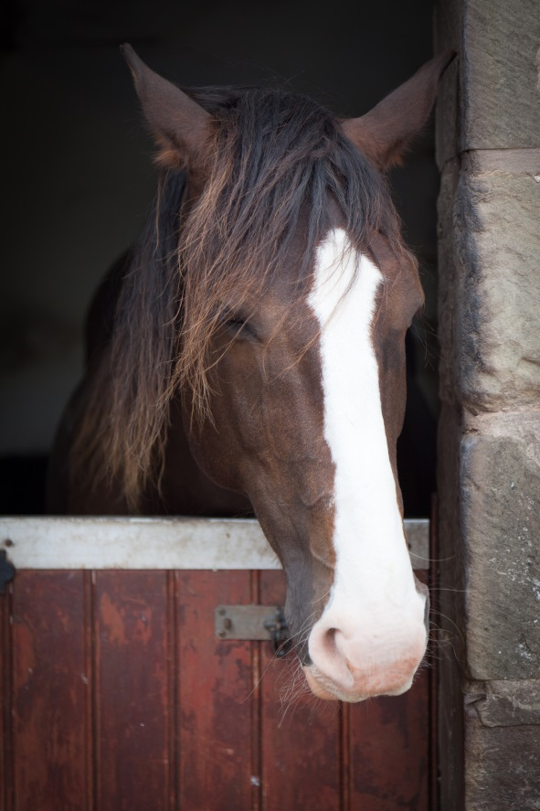
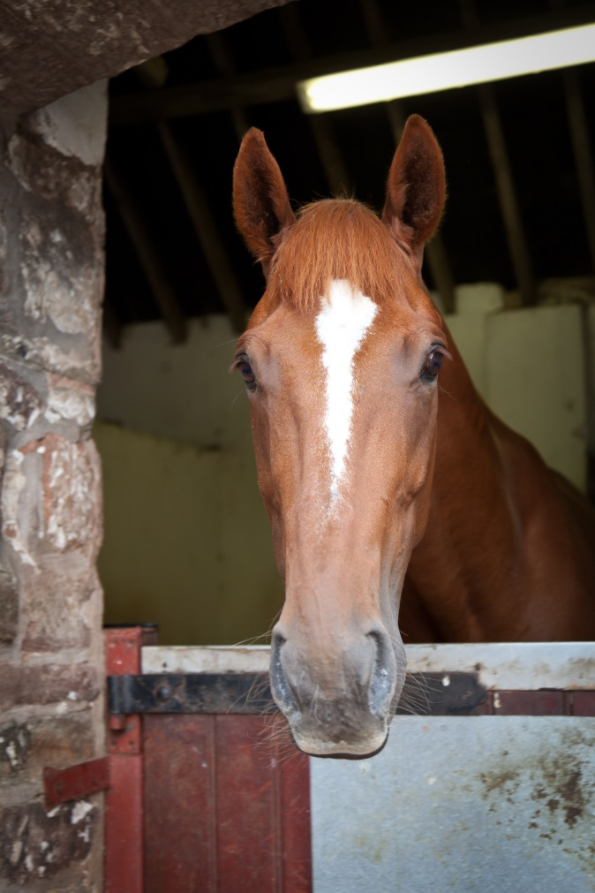
Ears!
Notes:
As a group describe some facial expressions that indicate the horse is: happy, alert, unhappy,
Discuss the two horses in the pictures – what do the group think they are showing?
Either as a group or divided into smaller groups discuss the horses shown on the following slides
(Can also use these slides as a revision of colours and markings from part one)
Consider adding other relevant pictures or videos clips to this section

Slide 7
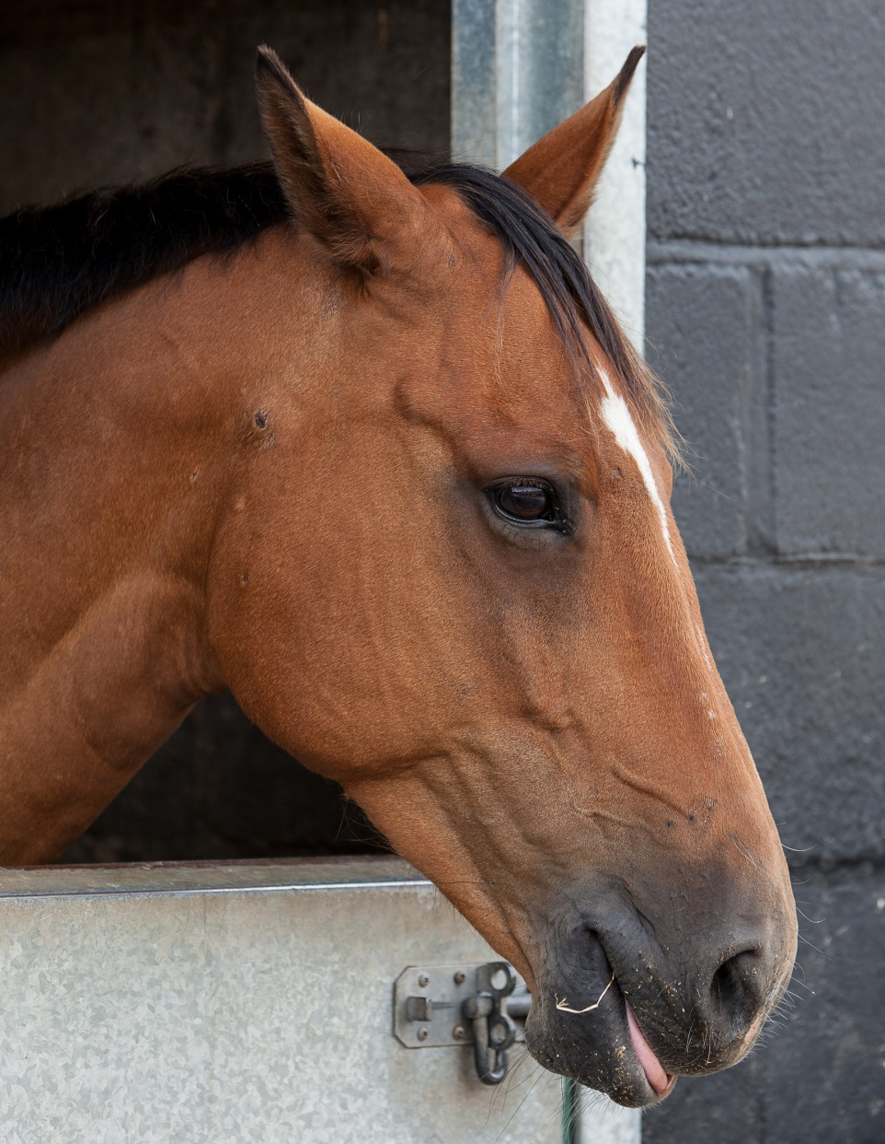
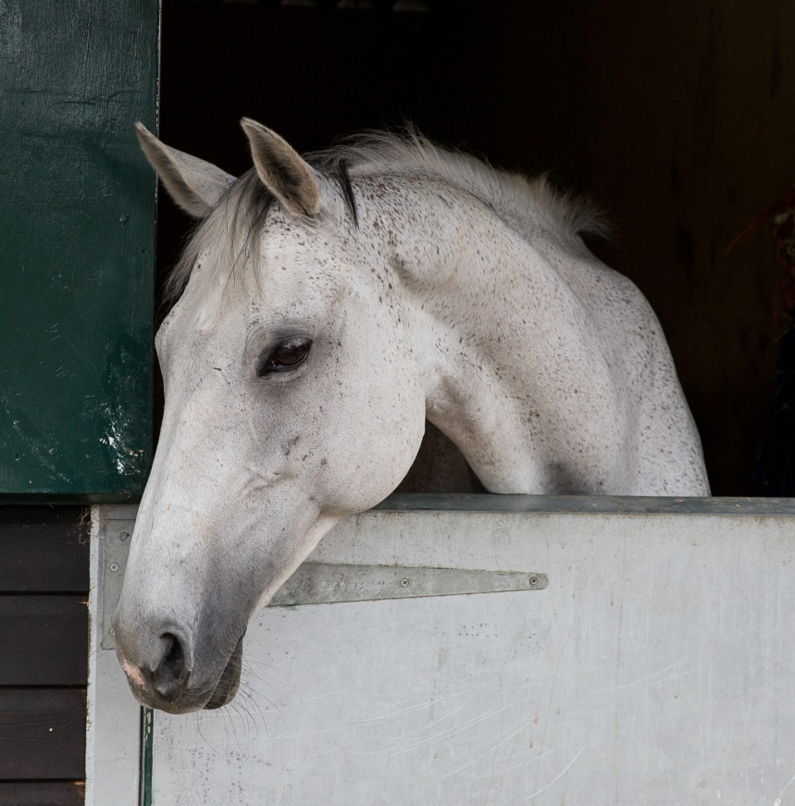
Notes:
Discuss each horse in the picture (these pictures are the same as the booklet)
Discuss what the group can see in terms of body language as well as the facial expression e.g. relaxed muscles, wide eye, relaxed nostrils, stance. What kind of reaction would you expect if you approached each horse?

Slide 8
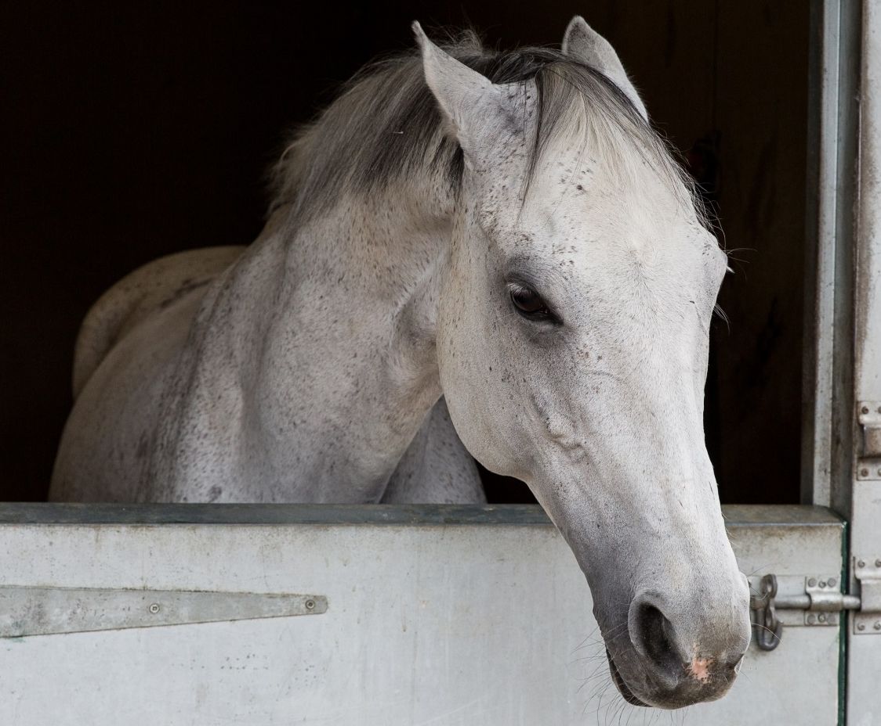
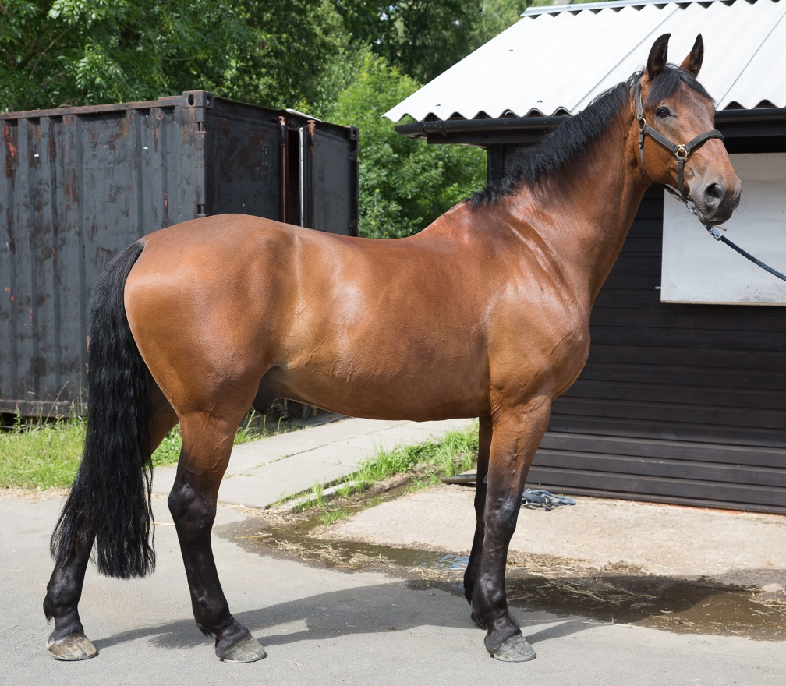

Slide 9
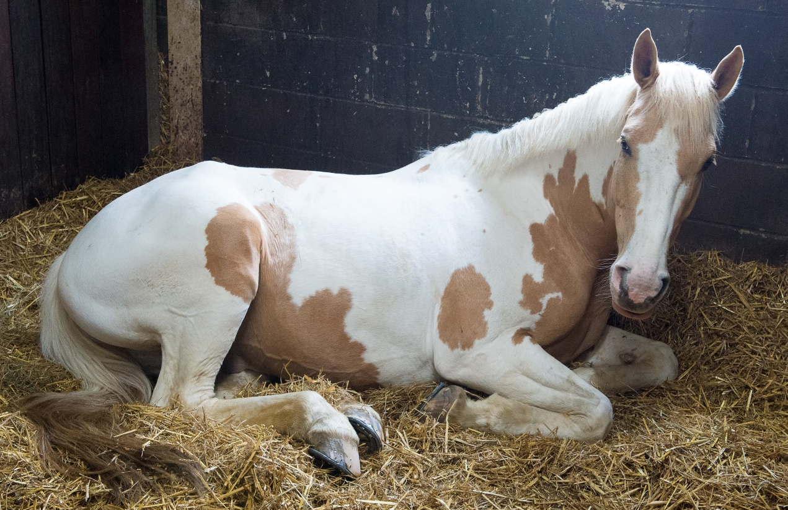
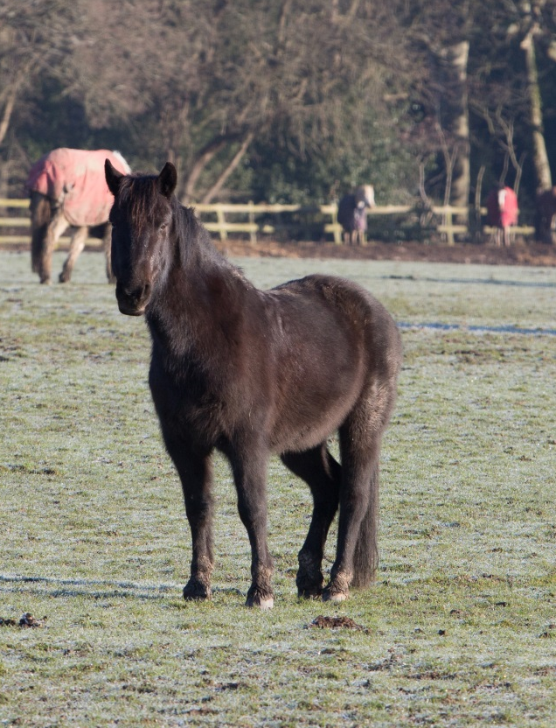
Notes:
Ask the group if they have seen a horse sleeping – lying down or standing up?
Discuss how horses sleep/doze
Is it normal to rest one leg more than other or switch from leg to leg?

Slide 10
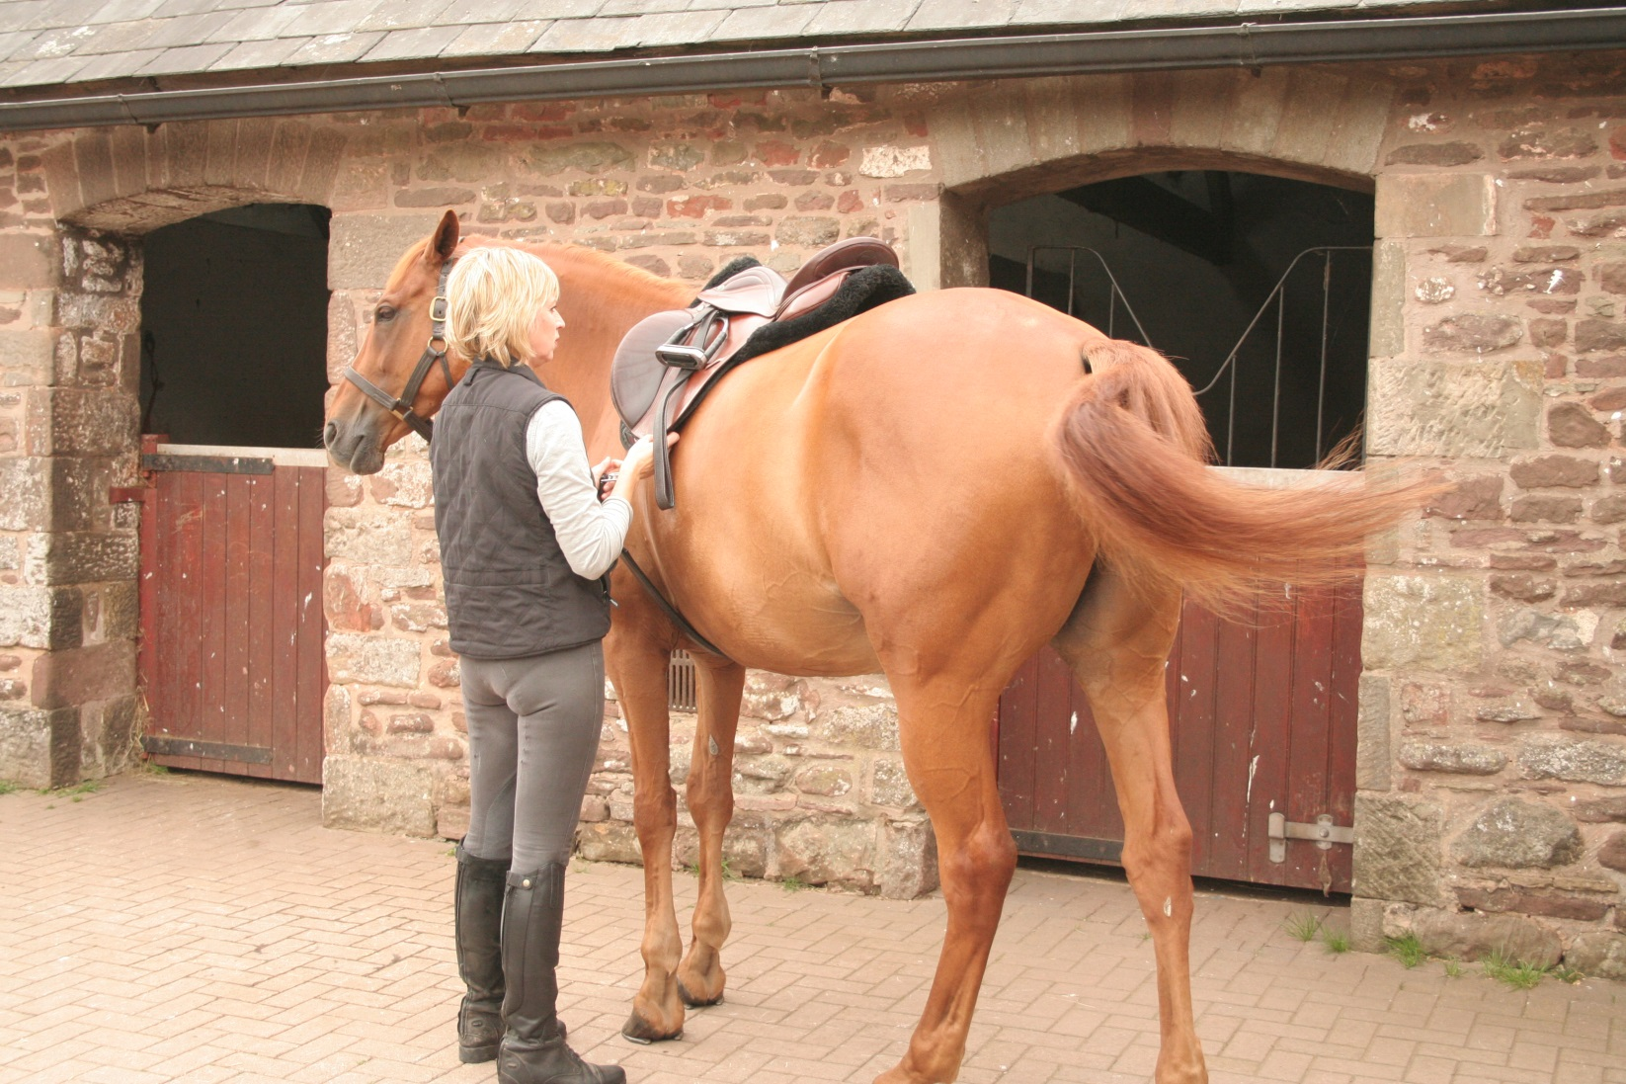
Tail Swishing
Notes:
Ask the group what other signs the horse may display to indicate how it is feeling?
Ask the group if they think paying attention to what the horse is doing with his tail is important?
What does the horse use his tail for?
What is the horse on the slide doing? Can they identify all the signs of discomfort – ears, face, tail, leg position
Discuss safe positioning while working round horse e.g. tacking up or grooming and the potential outcome if you don’t respond to what the horse is telling you.

Slide 11
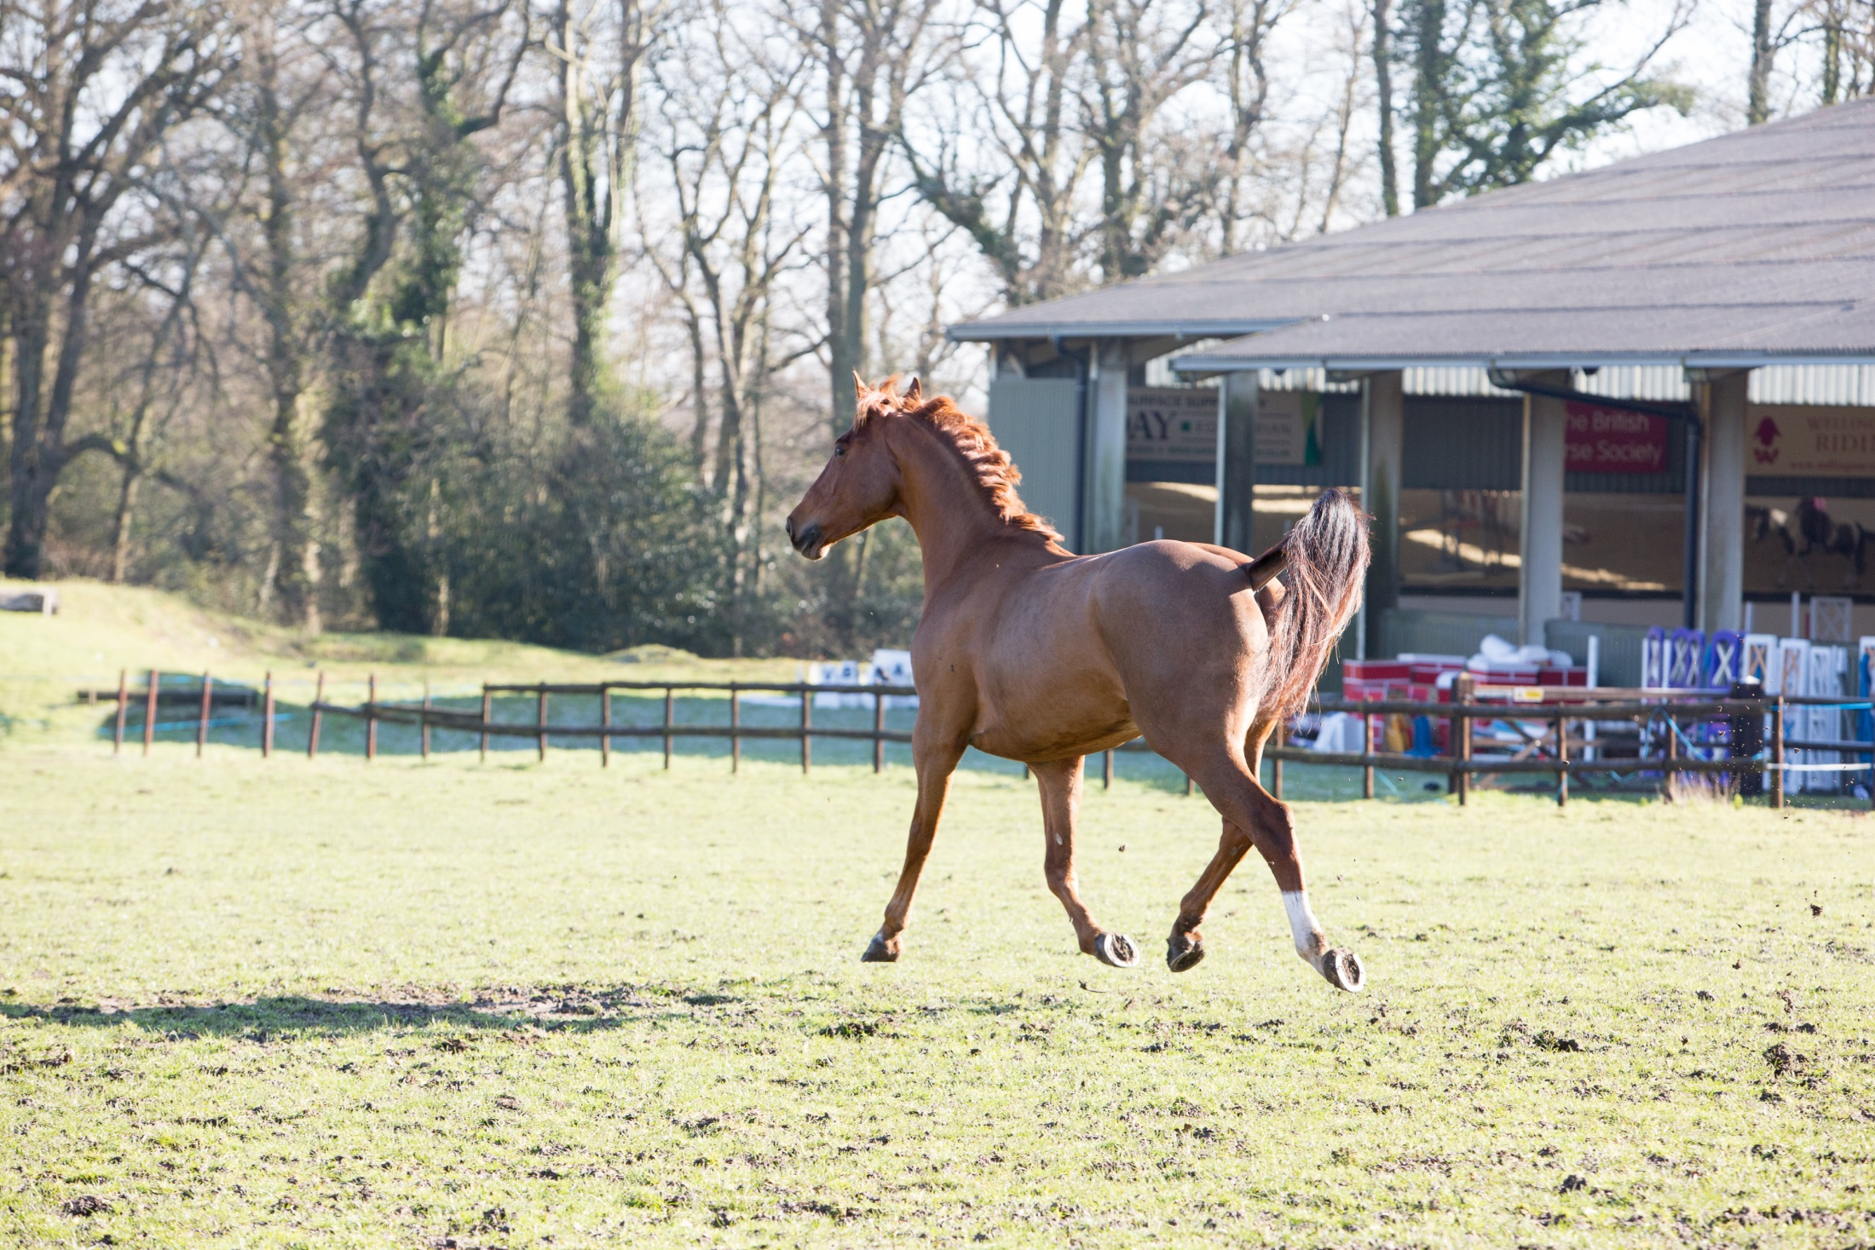
Notes:
How to tell if the horse is excited! Ask the group to suggest potential signs – describe the horse on the slide, why might he be acting like this
Do the group know of any breeds of horse that carry their tail high naturally?

Slide 12
Quick Quiz
Why is it important to recognise horse facial expressions and body language?
How might a horse that is protective of his stable react when you approach?
What might a sensitive horse do when you groom him?
What behaviour would tell you your horse is relaxed
What behaviour might a horse that is excited display?
Notes:
This quiz is very informal and is not designed to be a test. Answers can be written or verbal and there is space for the participants to write answers in their booklet.
Suggested answers:
To recognise how the horse is feeling and may react to you or the situation
He might put his ears back, pull a face, wrinkle his nostrils, stretch head and neck out towards you or any other description discussed within the sessions
He might swish his tail, put his ears back, stamp a foot, kick out, move away
Such as: Head down, droopy lip, ears relaxed, resting hind leg
Such as: Head and neck raised, ears pricked, tail carried

Slide 13
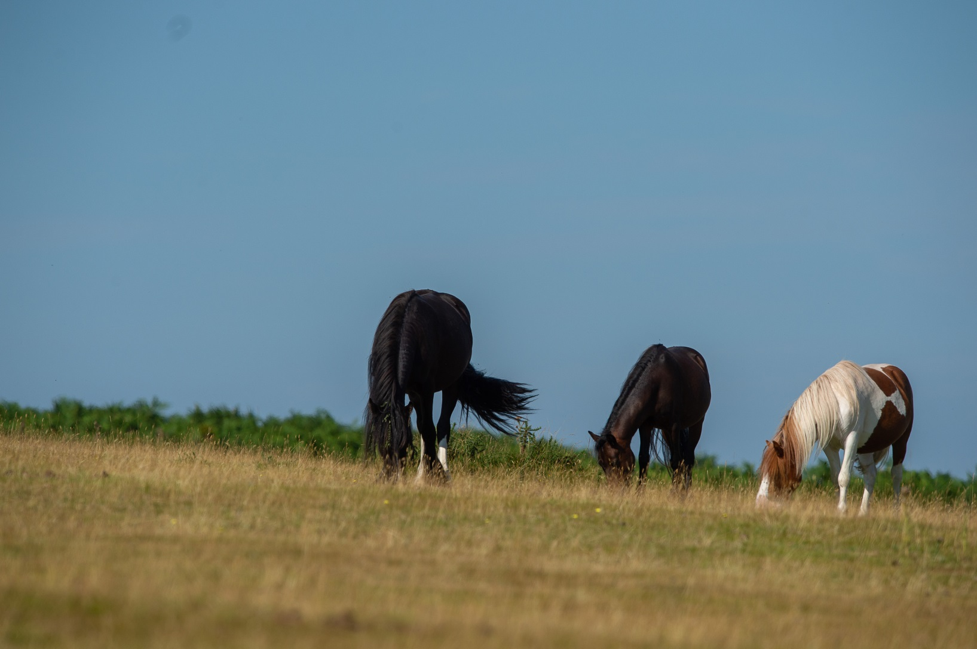
Horse Knowledge
Horse Care
Notes:
This section covers passports and microchipping.
Discuss as a group reasons for needing to keep records and identification documents for horses and how this might be done
Can the group think of any potential issues?

Slide 14
Microchipping
Tiny chip the size of a grain of rice
Inserted into the ligament running down the top of the neck
Has to be carried out by a vet
Read by handheld scanner
Notes:
Discuss the reasons for Microchipping – horses, dogs, cats…… any other animals?
Discuss why they are used and if the group think they are a good idea?
Can they think of any issues with using microchips?

Slide 15
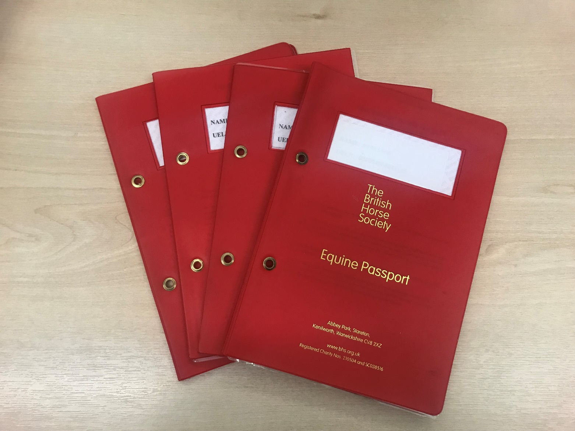
Passports
Notes:
Discuss equine passport and what it is.
If possible have a passport to show the group and go through each section, look at the vaccination page, not intended for human consumption page, silhouette page (an example is shown on the next page)
Discuss as a group some white face and leg markings (revision from part one)
Discuss how some injuries can damage the hair and cause it to grow back white
Ask the group if they can describe what a whorl is?
Ask your local vets or download a silhouette of the horse used in a passport for the participants to complete. Give out pictures of a horse to copy – could award a prize for the best one!

Slide 16
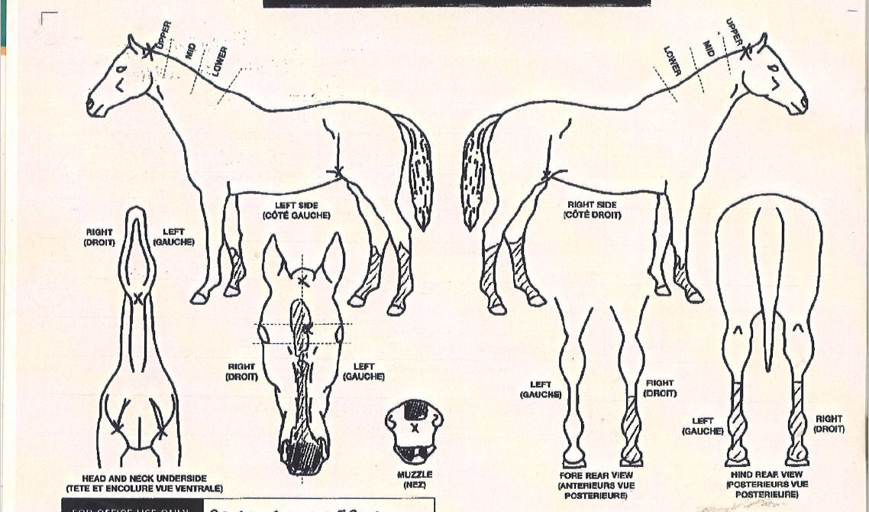

Slide 17
Freeze Marking
Freeze marks
  Used as a visual deterrent against theft
  Relatively pain free to apply but causes the horse stress
  Permanently damage the pigments cells to turn the hair white
Notes:
Discuss horse theft and methods of deterrent link back to microchip
What can owners do to help deter theft or make it easier to identify their horse
Discuss the process of freeze marking

Slide 18
Brand marking
  Brand marks
    Used to identify some breeds or studs
    Painful for the horse
    Not recommended or supported by the BHS
Notes:
Discuss the process of branding. Do the group think it is ethical as it is known to cause horses pain?

Slide 19
Quick Quiz
What is a microchip?
What details can be obtained from a microchip
Does every horse require a passport?
List two things that are recorded in a passport
List three markings the vet would record on the passport diagram of the horse
What is a freeze mark?
Why might an owner have their horse freeze marked?
Notes:
This quiz is very informal and is not designed to be a test. Answers can be written or verbal and there is space in the booklet for participants to write their answers.
Suggested answers:
A small chip the size of a grain of rice
The horse’s unique number, details of horse and owner
Yes
Such as: name, oner details, breeding details, vaccination details, silhouette, markings, unique life number, declaration for food chain, or any other information
Colour, markings, scars, brand/freeze mark, whorls
A unique combination of symbols, letters or numbers applied to a horse’s back/shoulder or neck by a cold iron
As a visual deterrent to theft

Slide 20
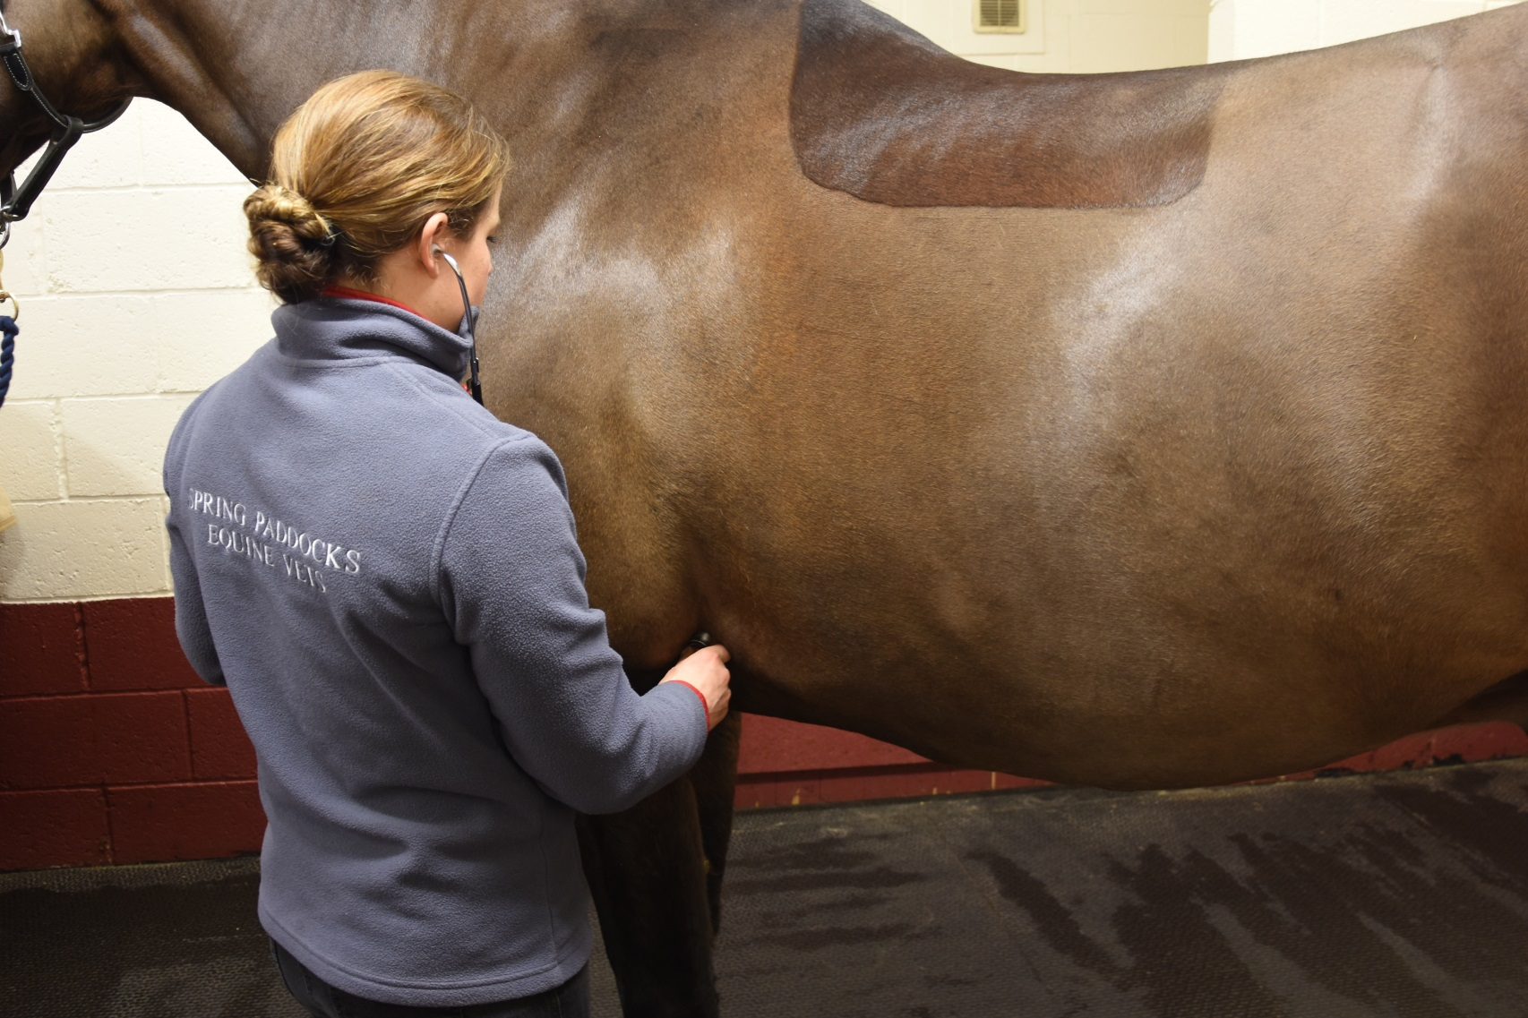
Horse Knowledge
Signs of health
Notes:
This section introduces signs of health and illness starting with the basic signs of health to look for during daily checks.
It then touches on preventative methods such as vaccination and the importance of disease prevention (bio-security)

Slide 21
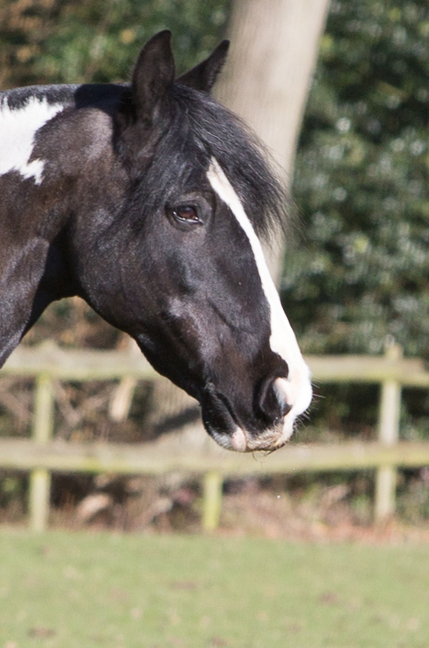
Signs of good health
EYES
Bright
Clear
Open
NOSTRILS
Clear
Relaxed
APPETITE
Eating and drinking normal amount
Chewing evenly
Not dropping food
Notes:
Signs of health
In small groups discuss what signs of health they would look for in the horse
Starting with the headings : eyes, nostrils, appetite which are in the participants booklets
Create a master list and discuss each point raised
Participants to fill in booklet with signs of health

Slide 22

Signs of good health
Body
Ideal weight
Shiny coat
No lumps, swellings, heat
Legs
Standing evenly on all four legs
No heat, lumps, bumps, swellings
Moving normally
General appearance
Alert and interested
Muscles relaxed
Droppings
Firm, break when hit ground
Normal amount
Notes:
Discuss in small groups the headings: Body, Legs, General appearance, Droppings
Create a master list on flip chart/white board and discuss each point raised
Participants to write notes in their booklets

Slide 23
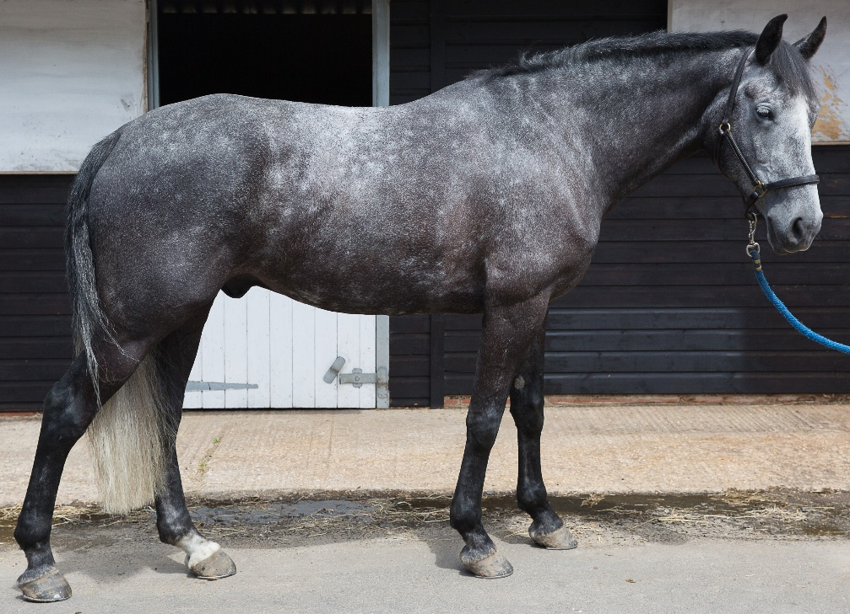
Signs of ill health
Eyes:
Dull
Cloudy
Partially closed
Nostrils:
Discharge
Blood
Flared
Appetite:
Not eating or drinking
Eating or drinking less
Very firm or loose droppings
Body:
Underweight
Overweight
Tight skin
Dull coat
Legs:
Limping
Not able to stand evenly when asked
Heat
Swellings
Cuts
General appearance
Quiet/withdrawn
Lack of interest
Tight muscles

Slide 24
Preventing the spread of disease
Equine flu
  Highly contagious
  Can be transferred from horse to horse
  Signs include: coughing, nasal discharge and high temperature
    Vaccination greatly reduces the symptoms
    Tetanus
    Can be fatal
    Horses more susceptible because of the environment they live in
    Vaccination offers complete protection
Notes:
Prevention is better than cure… as a group discuss why – include humans as well as animals!
Ask the group if they are aware of any vaccinations available for horses?
Briefly discuss Equine Flu symptoms. Include the recent outbreak and how it has affected the equine world
Briefly discuss tetanus symptoms – can affect horses and humans!
Discuss the initial vaccination programme for flu and tetanus and the boosters required after.
If possible have a look at some vaccination records and work out the initial course and which are flu and flu/tetanus

Slide 25
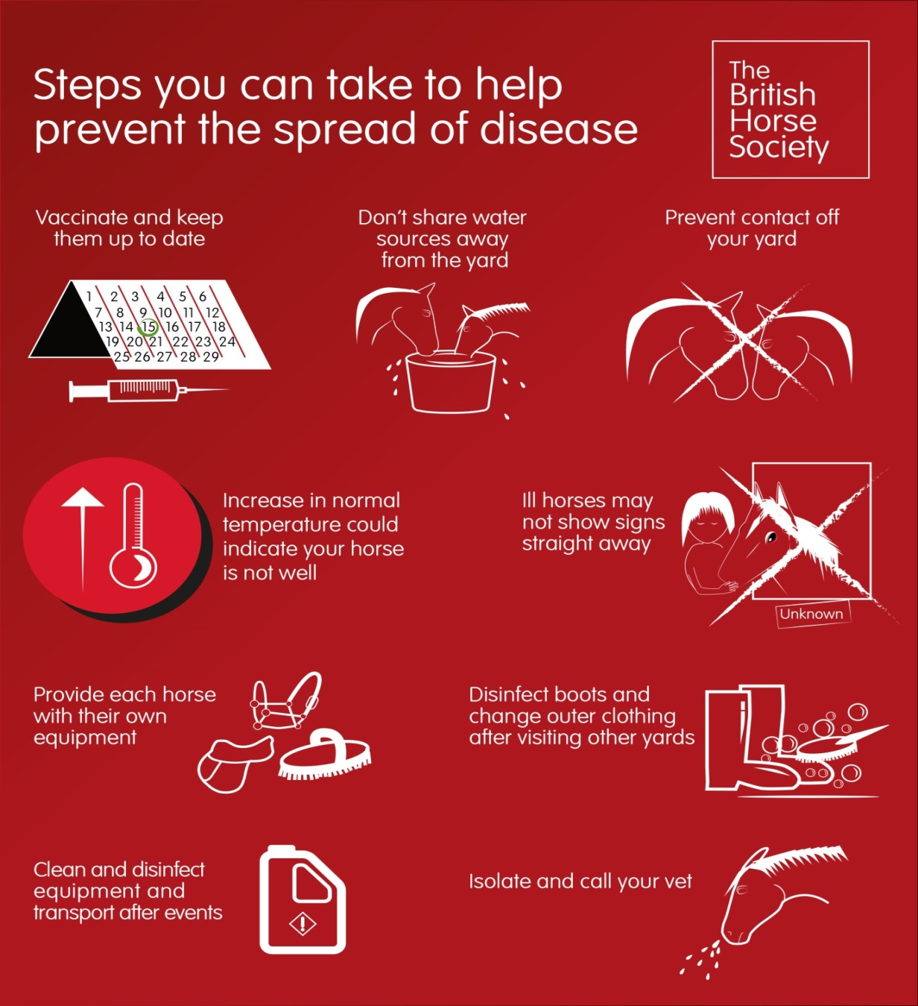
Disease prevention
Notes:
Ask the group what they understand by the term Disease prevention
Ask the group if they can think of any issues with people touching horses around a yard, sharing equipment between horses, letting unknown horses touch each other at competitions/events, bringing new horses onto a yard?
Can they think of any biosecurity rules in place at a yard
Discuss each of the points on the infographic and how they can help to prevent the spread of disease

Slide 26
Quick quiz
List four signs of good and ill health
What two illnesses can be vaccinated against in the UK?
How often are booster vaccinations required for each of these illnesses?
Why is it not a good idea to share brushes between horses on a yard?
List two things you can do to prevent the spread of disease between horses on the yard
Notes:
This quiz is very informal and is not designed to be a test. Answers can be written or verbal and space is available for participants to write answers in their booklets.
Suggested answers:
Any four for each from session discussions
Equine flu and Tetanus
Flu – every 6 months, Tetanus – every 2 years
Disease can be passed between horses
Any 2 suggestions from discussions in session or the disease prevention poster

Slide 27
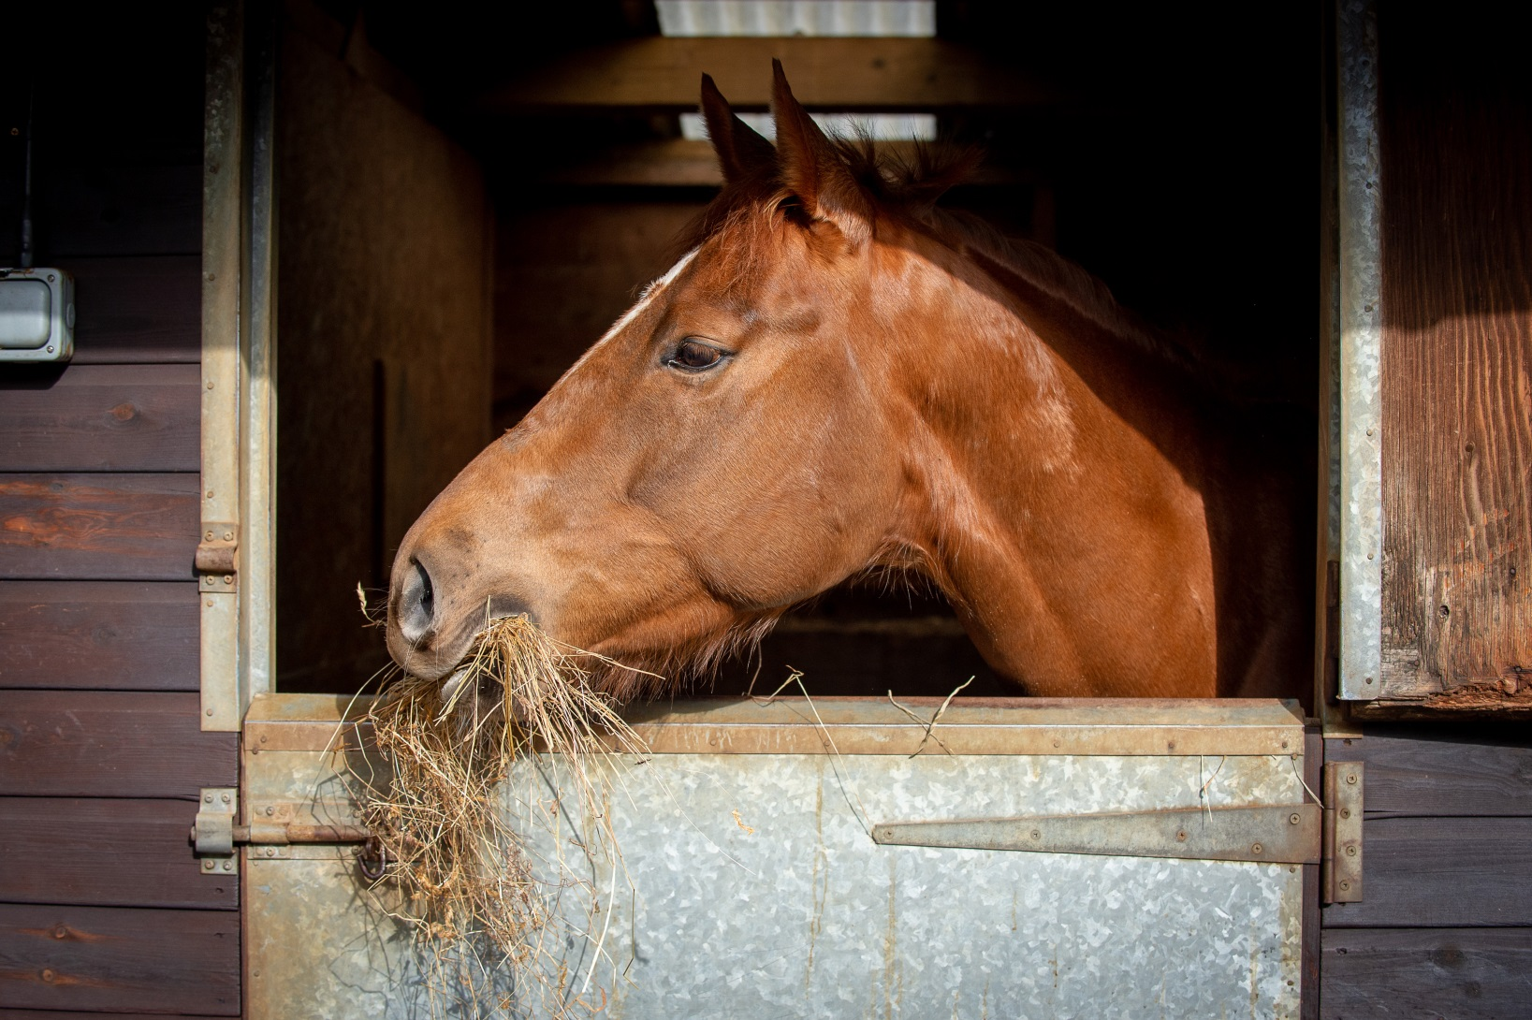
Horse Knowledge
Feeding
Notes:
The feeding section covers a brief overview of the digestive system, the types of feed that horses can eat and what is not suitable for them.
Basic introduction to common types of bucket feed (chaff, alfalfa, mix, cubes, sugar beet)
Consider bringing in feed samples to show the group

Slide 28
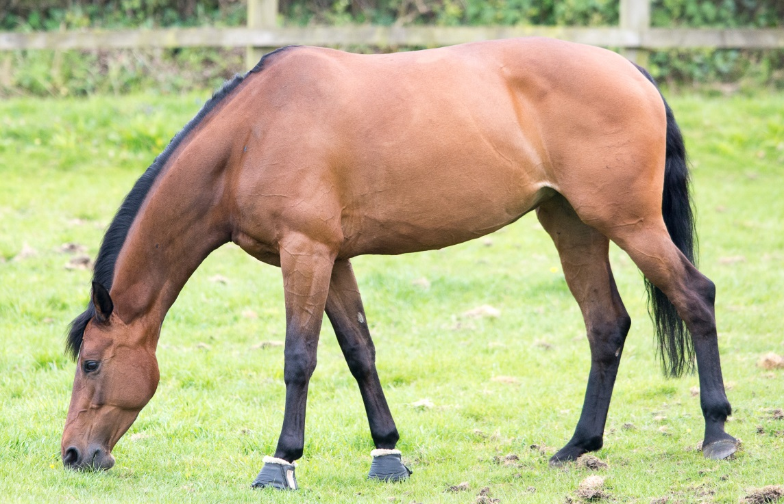
The digestive system
Through the intestines
Into the stomach
To the rectum
Swallowed down the oesophagus
Droppings passed out of the anus
Starts with
the mouth
Notes:
The digestive system
Give a brief overview of the digestive system in basic terms
Participants have the same diagram in the booklet to complete

Slide 29
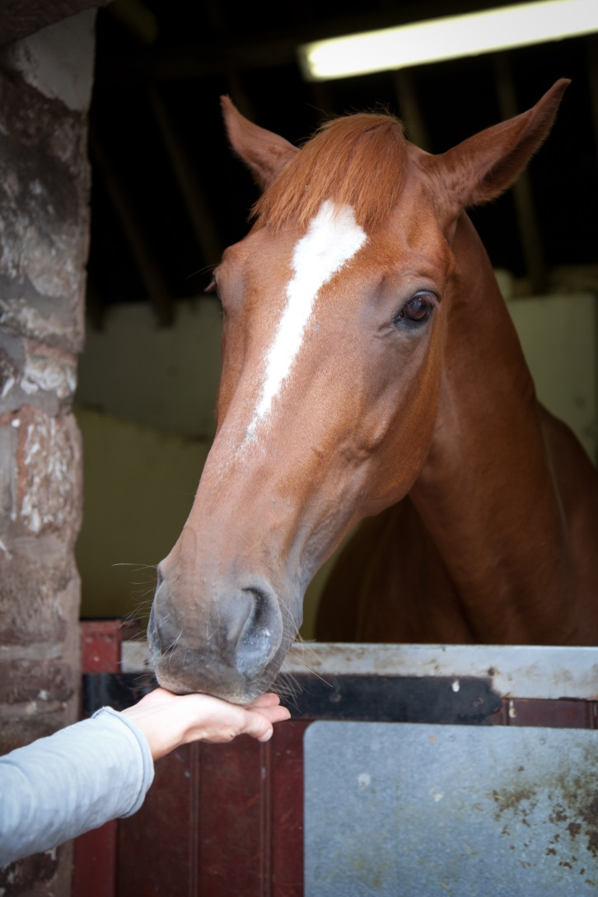
Treats
Notes:
Ask the group if anyone feeds horses treats
As a group discuss what kind of treats they think are suitable for horses. Any surprising suggestions? Has anyone made their own treats for their horse?
Discuss the issues with horses expecting treats regularly.
Discuss ways of feeding treats – by hand, in bucket, treat balls etc
Why should grass cuttings should never be fed to horses?

Slide 30
Rules of feeding
Clean fresh water should be freely available
To keep the horse hydrated
The main part of the diet should be fibre based
The horse’s digestive system works most efficiently on fibre
Don’t work your horse straight after a bucket feed
To allow the horse to digest his food first
Feed little and often
The horse’s stomach is the size of a rugby ball and can’t cope with large amounts of feed in one go
Feed good quality feed
Feeding mouldy or dusty feed can cause illness
Always weigh each feed
To make sure the horse receives the same amount in each feed
Feed each horse as an individual
Every horse is different and their feed requirements will be different
Make Changes gradually
To allow the system time to adjust to the new feed
Stick to a routine
Horses thrive on routine
Notes:
Rules of feeding - ask the group (individually or discuss in small groups) to write down as many rules of feeding as they can and then create a list
The rules will appear on the slide when you click – you might want to add more to this slide or on a flip chart
Either as a group discuss each rule and the reasons for it or split into smaller groups and allocate each group a rule or two to discuss, then come back together to discuss the whole list and the suggestions given.
Participants have space in their booklet to write the reasons for each rule
In the booklet there are spaces for participants to write the reasons for each rule given on the slide

Slide 31
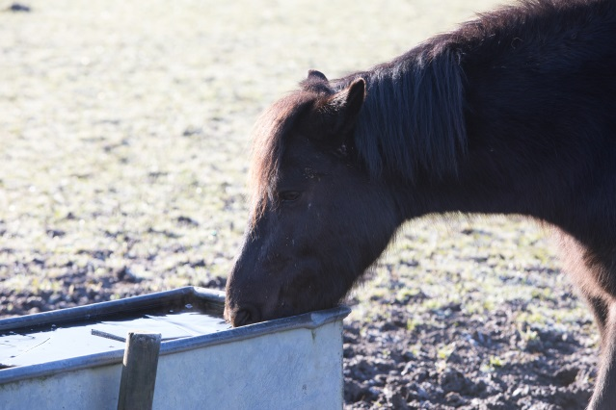
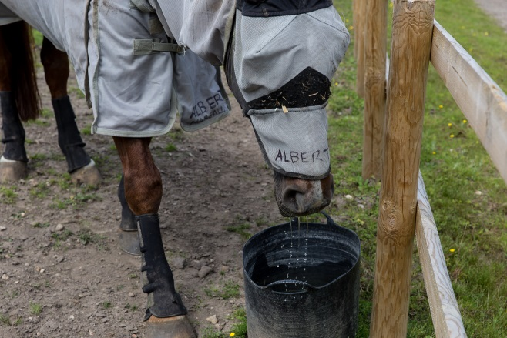
Methods of providing water
Method | Advantages | Disadvantages
Water bucket | Can monitor how much horse drinks. | Easily knocked over. Need to be refilled by hand.
Notes:
Split into small groups to come up with methods of providing water to horses in the stable (revision from part one) and the field and possible advantages and disadvantages of each.
Discuss the answers and write the on a flip chart or white board
Participants have this table in their booklet to complete.

Slide 32
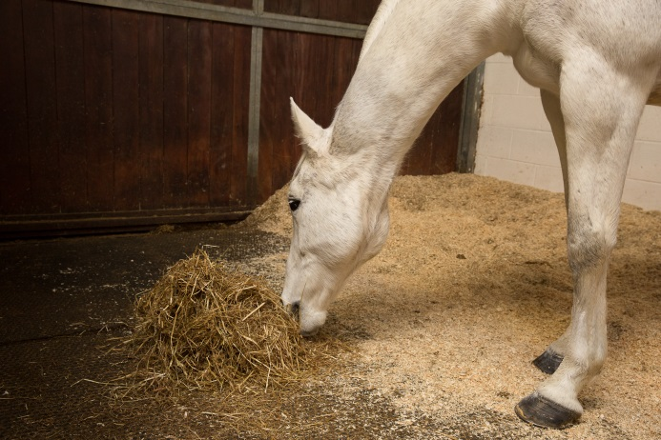
Feeding hay and haylage
Method | Advantages | Disadvantages
Eating from floor | Natural eating position for the horse | Can be wasteful
Notes:
Split into small groups to come up with different methods of feeding hay or haylage
Discuss the answers and write the answers on a flip chart or white board or add to table on slide.
Participants have this table in their booklet to complete

Slide 33
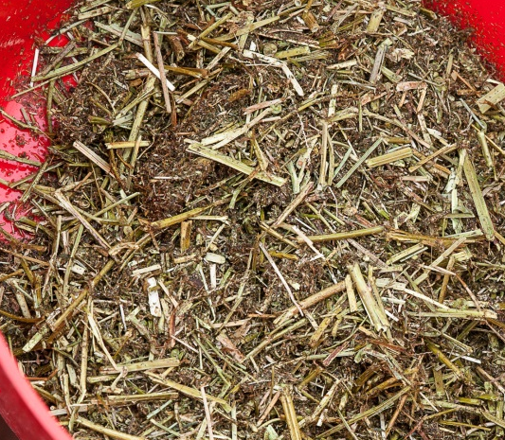
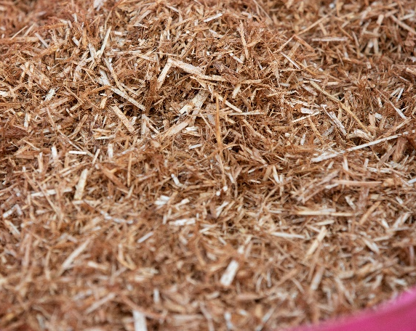
Types of bucket feed
Alfalfa
Chopped up Lucerne grass
Green colour
Chaff
Chopped up hay and straw
Brown colour
Notes:
Ask the group if anyone knows what the two feeds are in the pictures?
Discuss why chaff and alfa are used in bucket feeds and the differences between them.
There is space in the booklet for participants to write notes about each feed next to the picture

Slide 34
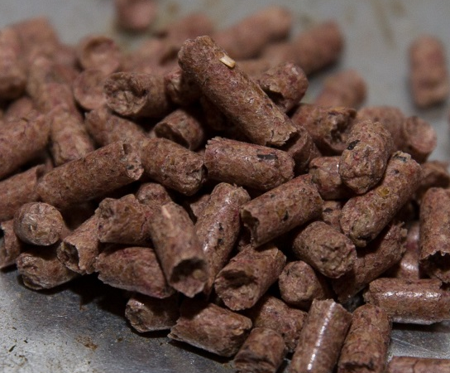
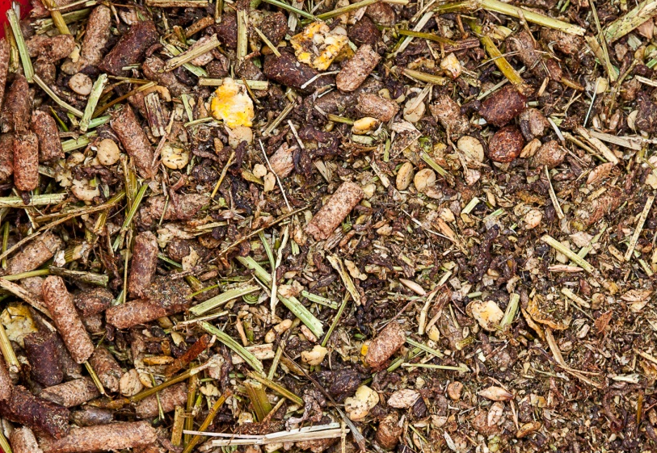
Types of bucket feed
Cubes
Ingredients have been compressed to form a pellet
Mix
Contains a mixture of grains, vitamins, minerals, cubes, carrots, peas and fibre
Notes:
Ask the group if they can identify the feed in the pictures
Discuss the basic differences between cubes and mix
There is space in the booklet for participants to write notes about each feed next to the picture

Slide 35
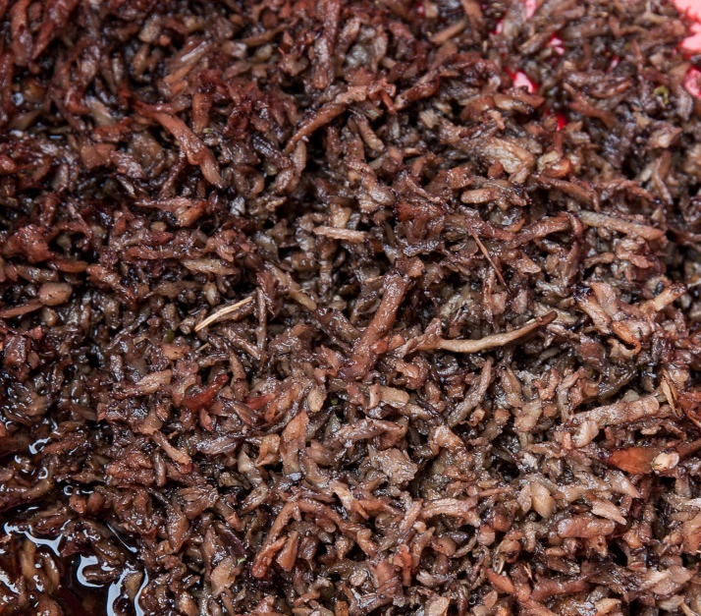
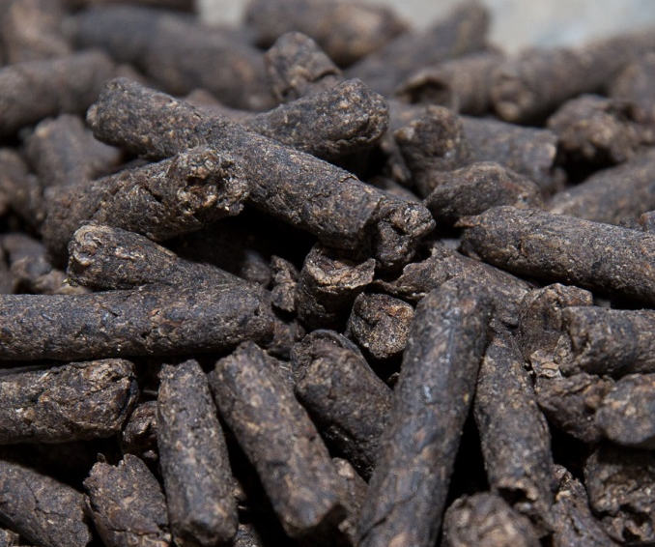
Types of bucket feed
Sugar beet
By product from sugar refining
Source of fibre
Must be soaked before feeding
Comes in cubes (shown below), flakes or shreds
Notes:
Ask the group if they can identify the feed in the picture and what is the difference between the pictures
Discuss how sugar beet cubes differ from normal cubes and what you should do if you are not sure

Slide 36
Quick quiz
List the parts of the digestive system
Why should you ask permission before feeding a horse
Name three treats suitable to feed horses
Why should grass cuttings not be fed to horses?
List three rules of feeding and give a reason for each
Why is chaff or alfalfa added to a bucket feed?
What is the main difference between mix and cubes?
What must you do to sugar beet before feeding it?
Notes:
This quiz is very informal and is not designed to be a test. Answers can be written or verbal and participants have space to write answers in the booklets.
Suggested answers:
Mouth, throat/oesophagus, stomach, intestines, rectum, anus
In case the horse has special dietary requirements, bites, isn’t allowed treats, or any other sensible answer
Any 3 treats from discussion in session or listed in booklet
It begins to ferment creating gas in the stomach which can cause colic
Any 3 from the rules given in the booklet and suitable reasons
To encourage the horse to chew, add fibre
Can’t see the content of a cube, mix tends to be molassed cubes aren’t or any other acceptable answer
Soak it for the recommended time (usually given on the bag)

Slide 37
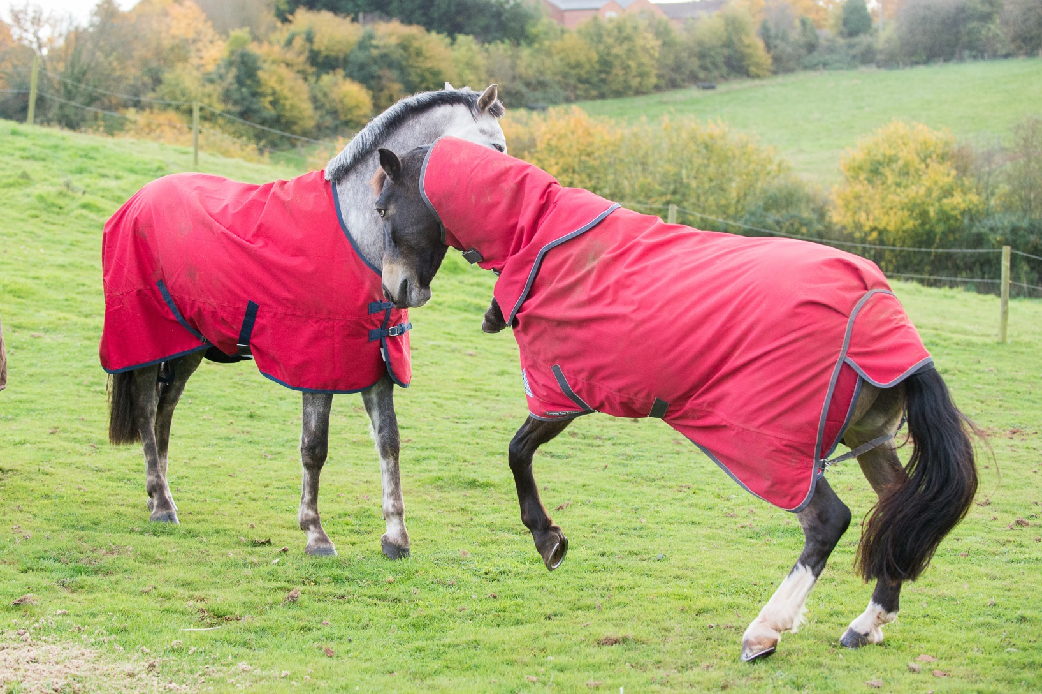
Field Care
Notes:
This section covers the basic fields checks and routine field care to ensure the field is suitable and safe to use.

Slide 38
What would your field check include:
Boundary
Water supply
Removing droppings
Poisonous plants
Rubbish
Holes
Notes:
Ask the group if they are aware of how much grazing is recommended for a horse. What could happen if there is not enough grazing/ too much grazing?
Ask the group to think about what kind of checks they would carry out daily/weekly/monthly on a field used for grazing horses and create a list.
Discuss what to look for in each check

Slide 39
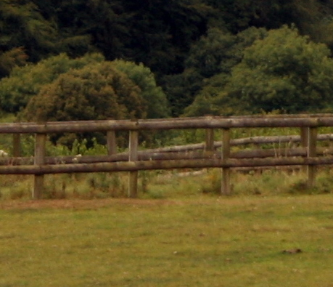
Boundary Fencing
Necessity to keep the horses in the field!
Various types:
Post and Rail
Can be plastic or wooden
Long lasting if looked after
Can withstand horses leaning/scratching on it
Notes:
Split the group into smaller groups and allocate each a fencing type or ask to come up with their own list. Ask them to consider the pros and cons of each type
Feedback to the rest of the group
There is space in the booklets for participants to write notes.

Slide 40
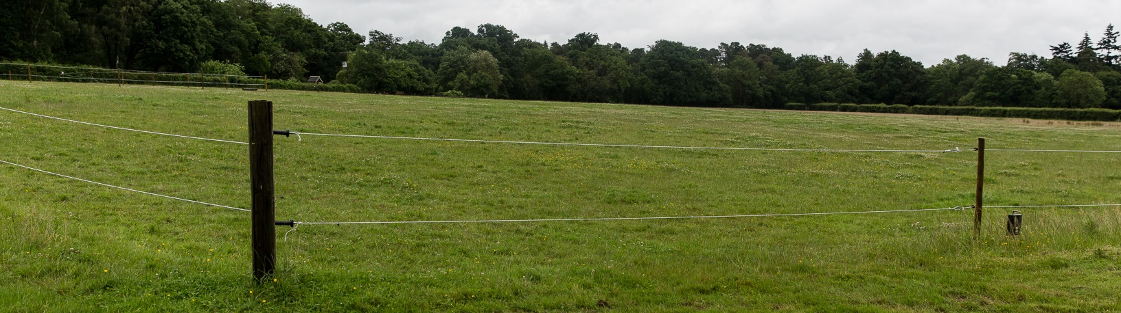
Electric fencing
Suitable as an inside boundary fence but should not be the only fence
Can be used with permanent posts
Can be used with moveable post to allow the field to be moved around
Strands need to be visible to horses
Can be powered by mains or battery packs
Notes:
Discuss

Slide 41
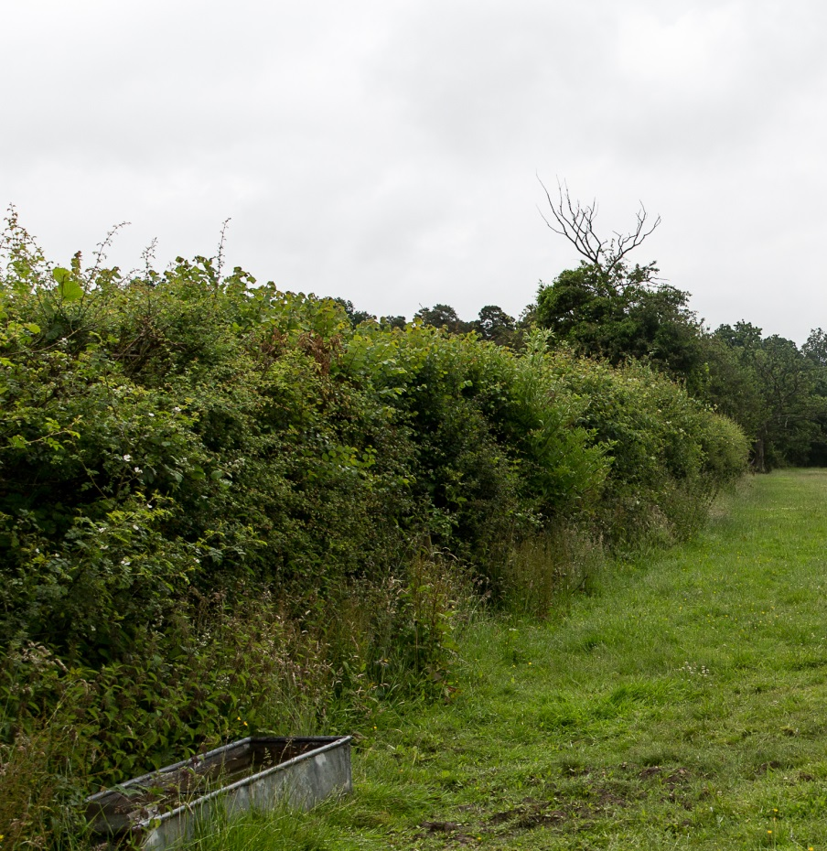
Hedges
Check that trees and bushes growing aren’t poisonous to horses
It needs to be thick enough horses can’t squeeze through gaps
Can be used with electric tape in front as solid boundary
Notes:
Discuss

Slide 42
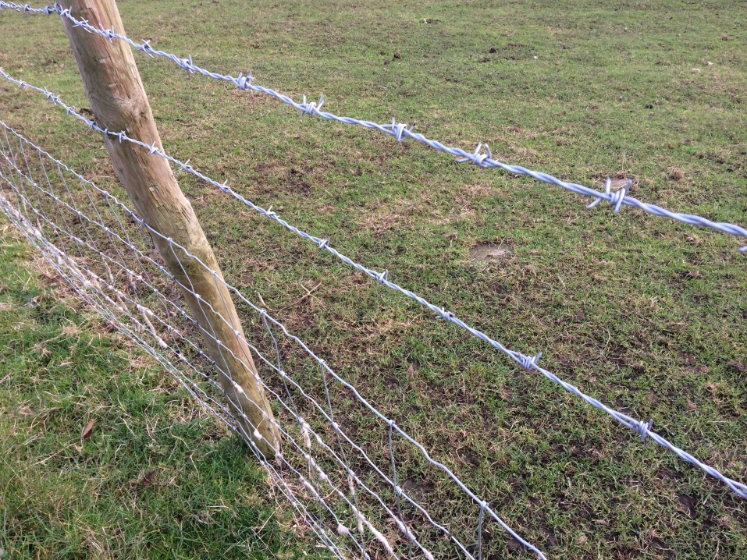
Barbed wire and stock fencing
Both of these types of fencing are unsuitable for horses
Barbed wire will injure the horse if he rubs on it
Stock fencing squares tend to be the same size as a hoof so there is potential for the horse to get his hoof or shoe stuck in it
Notes:
Discuss

Slide 43


Water supply
Notes:
Methods of supplying water has been covered in previous sessions – recap with group ways of providing water in field
Ask what checks they would carry out for each method of watering suggested

Slide 44
Picking up droppings
Reasons:
Horses don’t tend to eat grass near droppings
‘Lawns and roughs’
Parasite control
Notes:
Ask the group why they think you might need to remove droppings from the field?
Discuss briefly parasite control – overview of the lifecycle and why removing droppings breaks this cycle
Can discuss methods of removing droppings – wheel barrow and skip, machine etc

Slide 45
Parasites
Worms that live within horse’s body
Can cause irreparable damage to internal organs
Methods of controlling
Notes:
Briefly discuss what parasites are and how they can affect the horse
Include a basic overview of worm lifecycle and why removing droppings helps to control them
Discuss other methods of testing for worms

Slide 46
Any other checks?
Rubbish that has blown in or been dropped
Rabbit holes that a horse could put his foot down
Fallen or overhanging branches
Gate fastens securely
Anything else that could potentially injure a horse
Notes:
As a group ask for ideas of any other checks they might want to carry out to ensure the field is safe and suitable
Make a list to ad to the ones on the slide

Slide 47
Poisonous Plants
Check regularly for signs of poisonous plants growing
Can grow at any time of the year depending on species
Wear protective gloves
Dig up from roots where possible to prevent regrowth
Notes:
This section is an introduction to recognising common plants that are poisonous to horses
Remind the group that some are also toxic to humans so care must be taken when removing them
A selection of plants and trees are shown on the following slides, the same pictures are in the booklet with space to write the name underneath. Show the group each picture and ask if they recognise it.

Slide 48
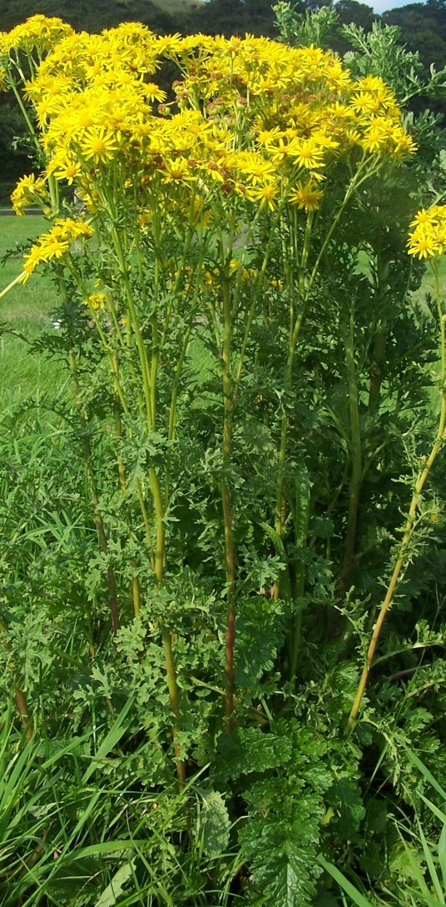
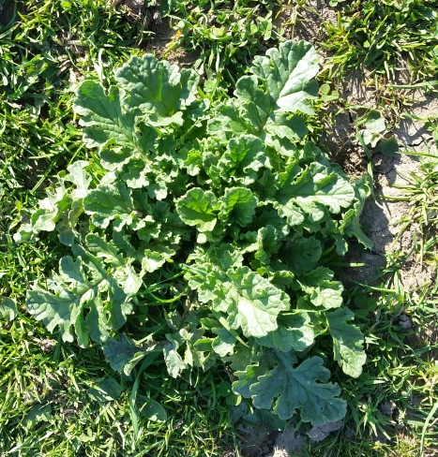
RAGWORT
In its first year it appears as green leaves growing in a rosette shape
In the second year it grows long stems with distinctive yellow flowers
Bitter taste so horses don’t tend to eat it unless grazing is very sparse
When dried it becomes more palatable
Remove by digging out from the roots
Notes:
Ragwort
Describe what to look for – rosette stage and the yellow flowers
If possible look at the ragwort toolkit

Slide 49
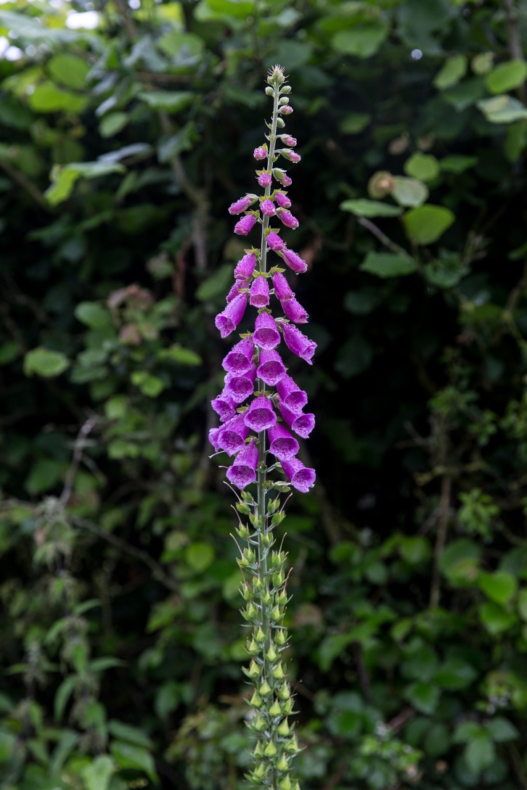
Foxglove
Also known as digitalis
Very poisonous to horses and humans
Tall tubular stem with bell-shaped flowers
Commonly seen with purple flowers but can have other colours such as white or yellow
Found in moorlands, woodland and hedgerows

Slide 50
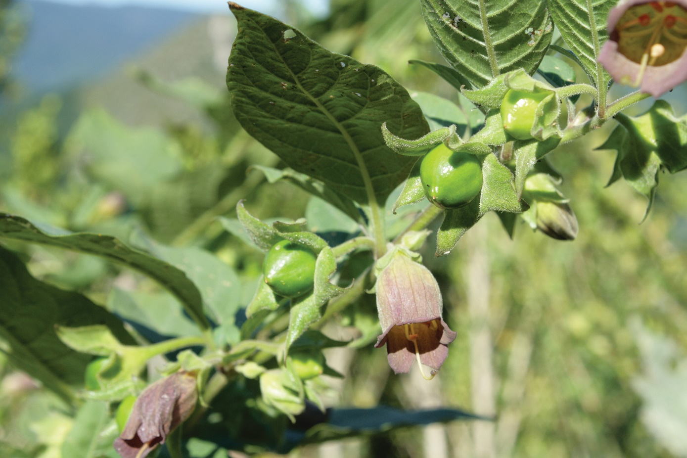
Deadly Nightshade
Bell-shaped purple flowers
Berries – colour ranges from green to black when ripe
Oval-shaped leaves with pointed ends
Likes to grow in woodlands, field margins and hedgerows
Not palatable to horses but may be eaten by accident if baled in hay

Slide 51
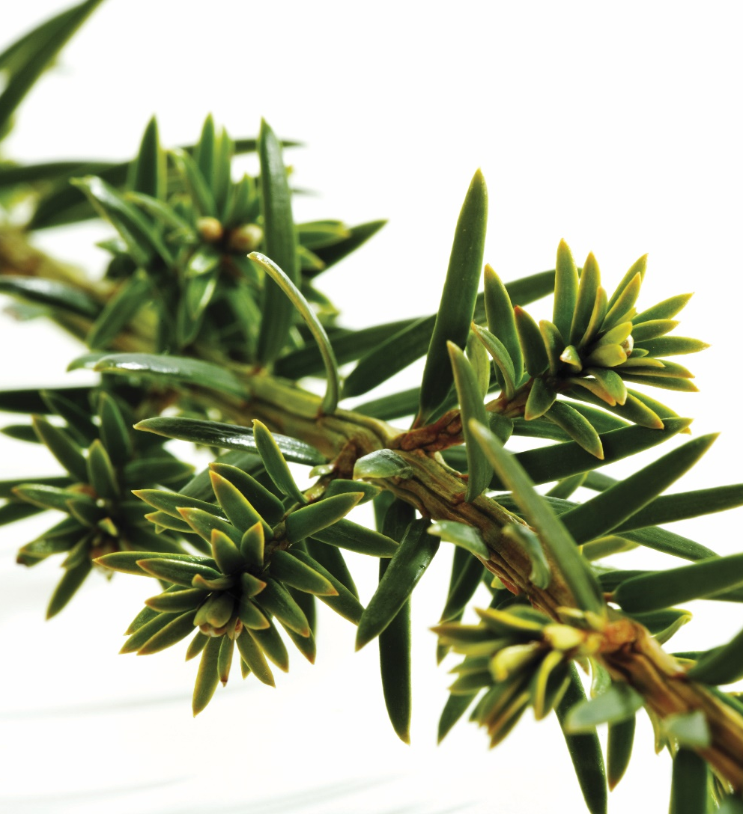
Yew
Highly poisonous to horses
Causes death almost instantly if eaten even in small amounts
Evergreen tree
Soft flat needle shaped leaves that are dark green on the surface and paler underneath

Slide 52
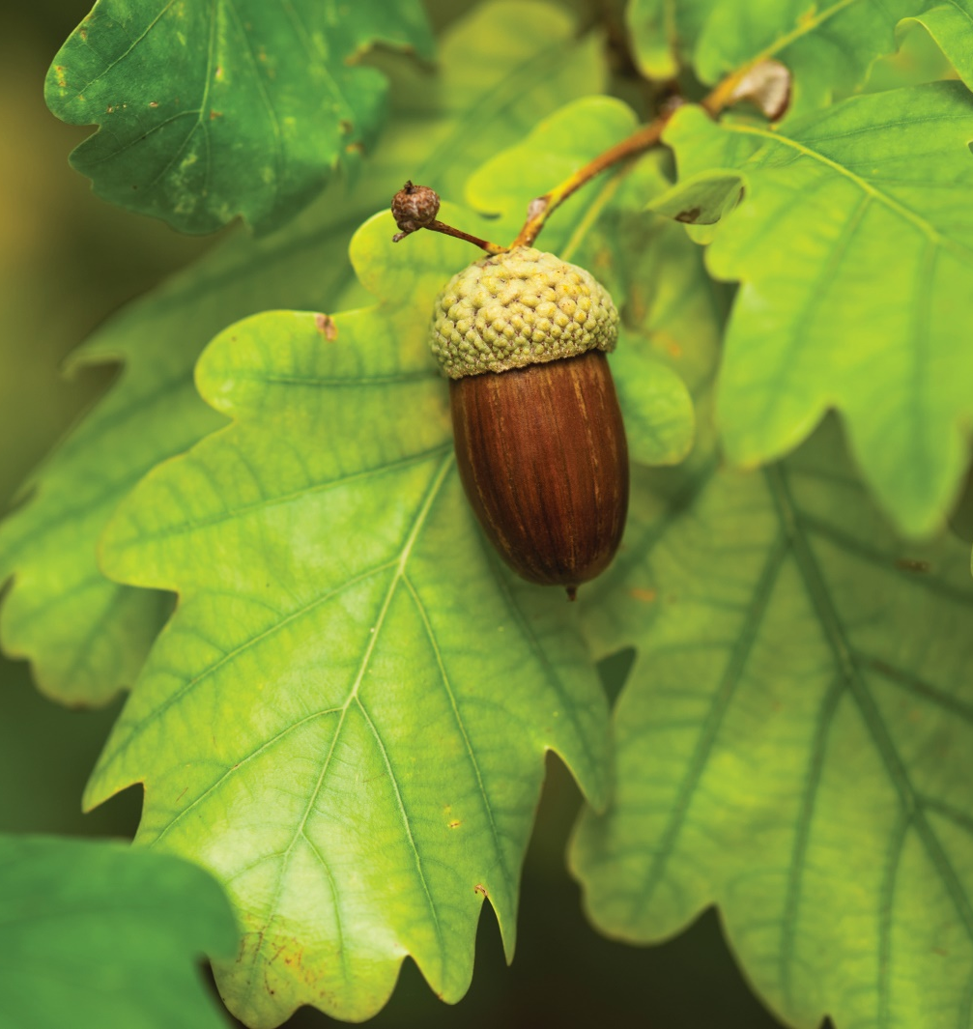
Acorns
Acorns grow on oak trees
The acorns, buds, leaves and blossom of an oak tree can all be toxic to horses
Oak tree leaves have lobes making them very recognisable
Acorns can be eaten when they fall off and can be toxic in large quantities
Trees should be fenced off
Oak trees don’t produce acorns every year

Slide 53
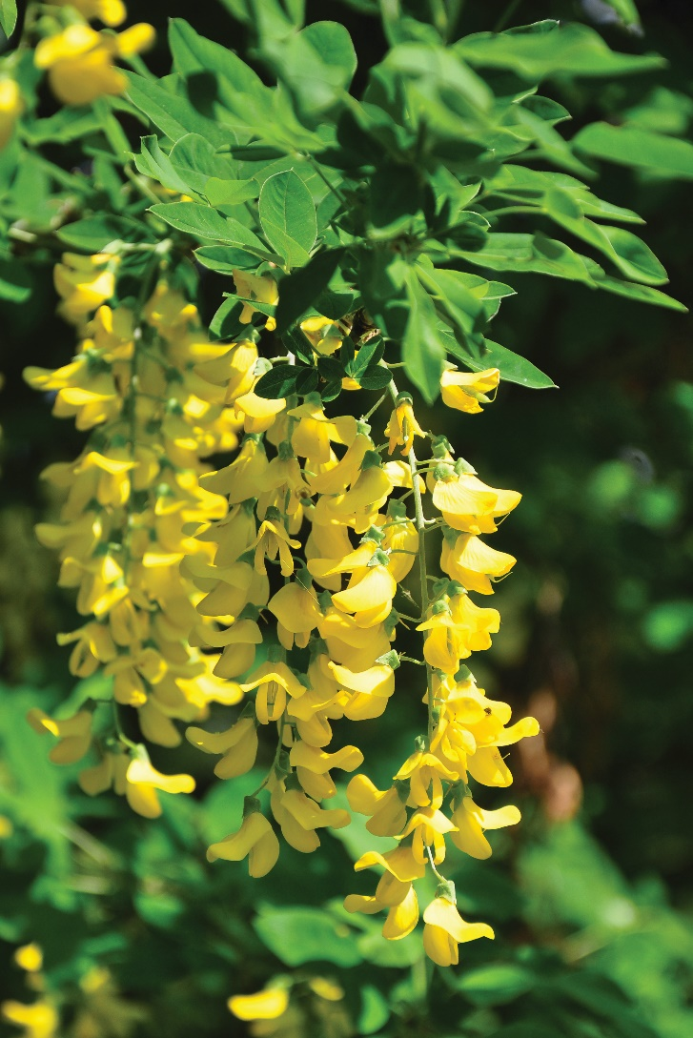
Laburnum
Highly poisonous tree
It has distinctive yellow flowers that hang in long clusters
Green leaves grow in threes
It has pea-like pods which contain black seeds
All parts of the tree are poisonous

Slide 54
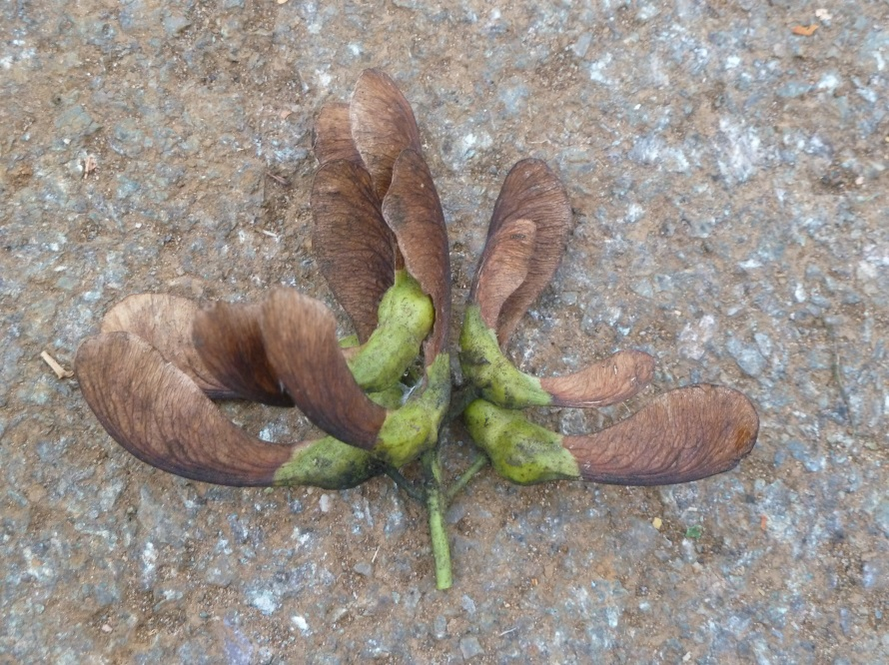
Sycamore Seeds
Sycamore tree is easily recognisable by its ‘helicopter’ seeds
These can travel large distances in the wind
When seeds or tree saplings are eaten they can cause Seasonal Atypical Myopathy which affects the horses muscles and can be fatal

Slide 55
Quick quiz
List three field checks that you would carry out daily
List two types of fencing suitable for horses
Why is barbed wire not suitable fencing for horses?
Name and describe two plants or trees that are poisonous to horses
Notes:
This quiz is very informal and is not designed to be a test. Answers can be written or verbal and there is space in the booklet for participants to write their answers.
Suggested answers:
Any 3 acceptable from the list in the booklet or discussed in session
Any 2 acceptable from the booklet or covered in the session
It can cut them if they lean on it, rip rugs, or any other acceptable answer
Any 2 from the list in the booklet or covered in the session.

Slide 56
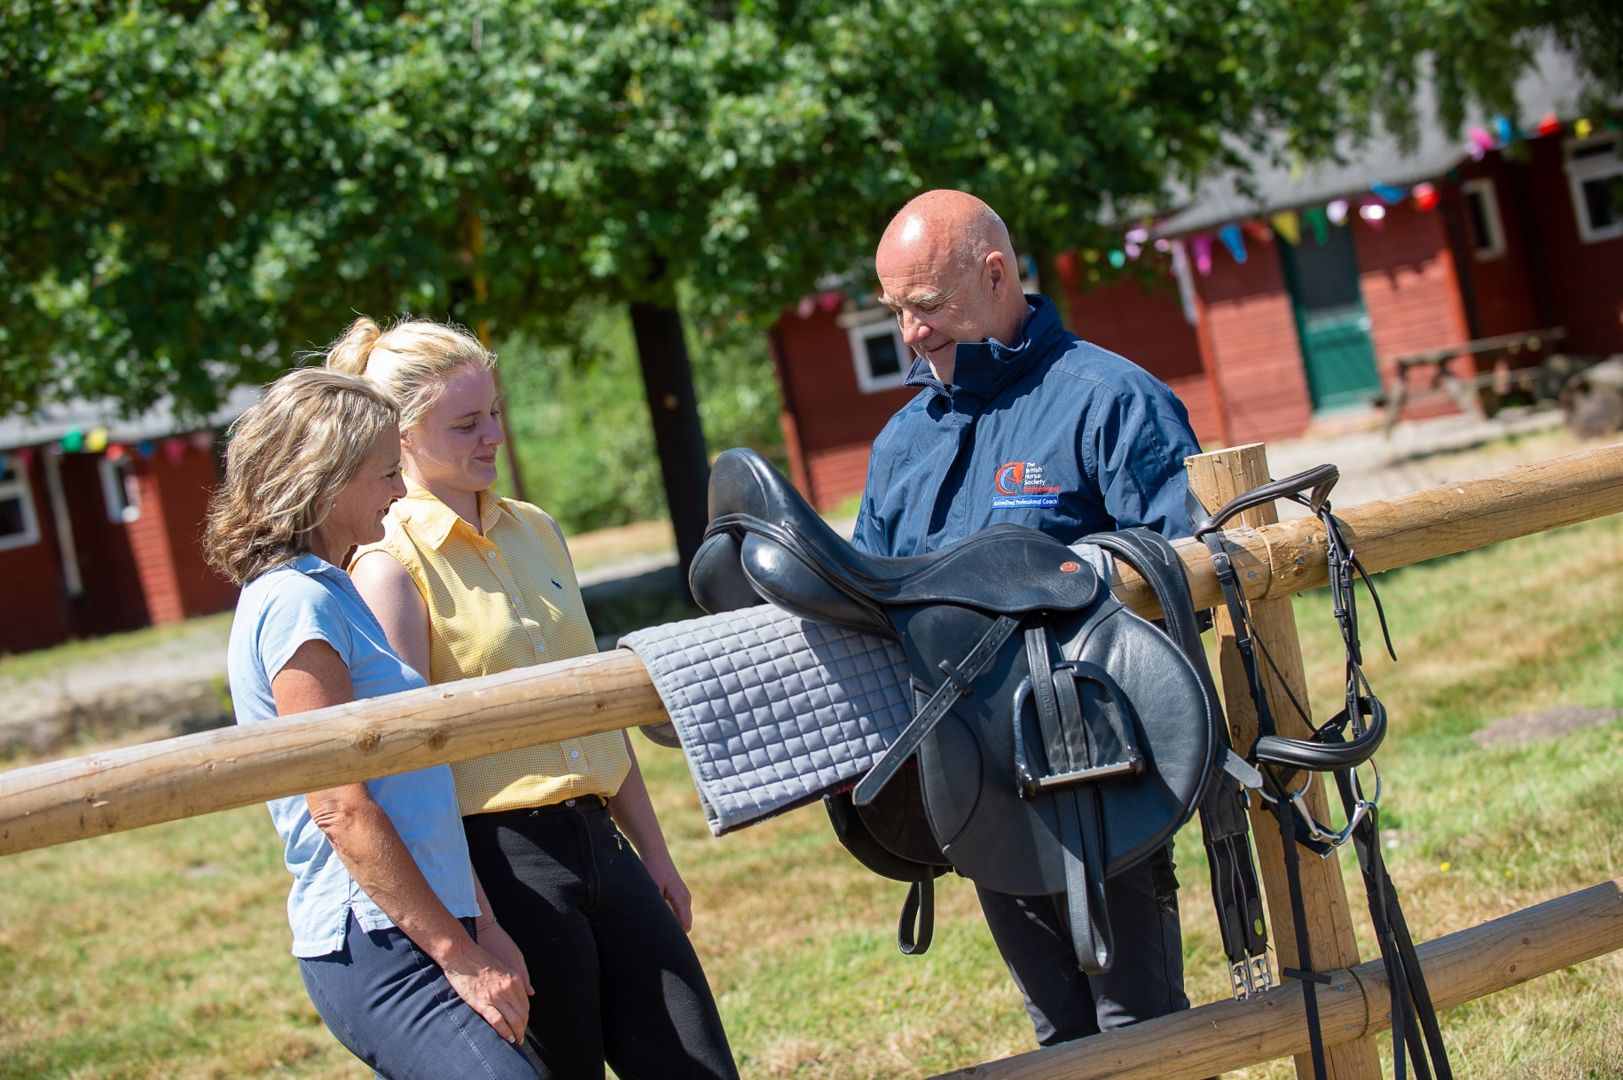
Tack
Notes:
This section introduces parts of the saddle and bridle in preparation for learning how to tack up.

Slide 57
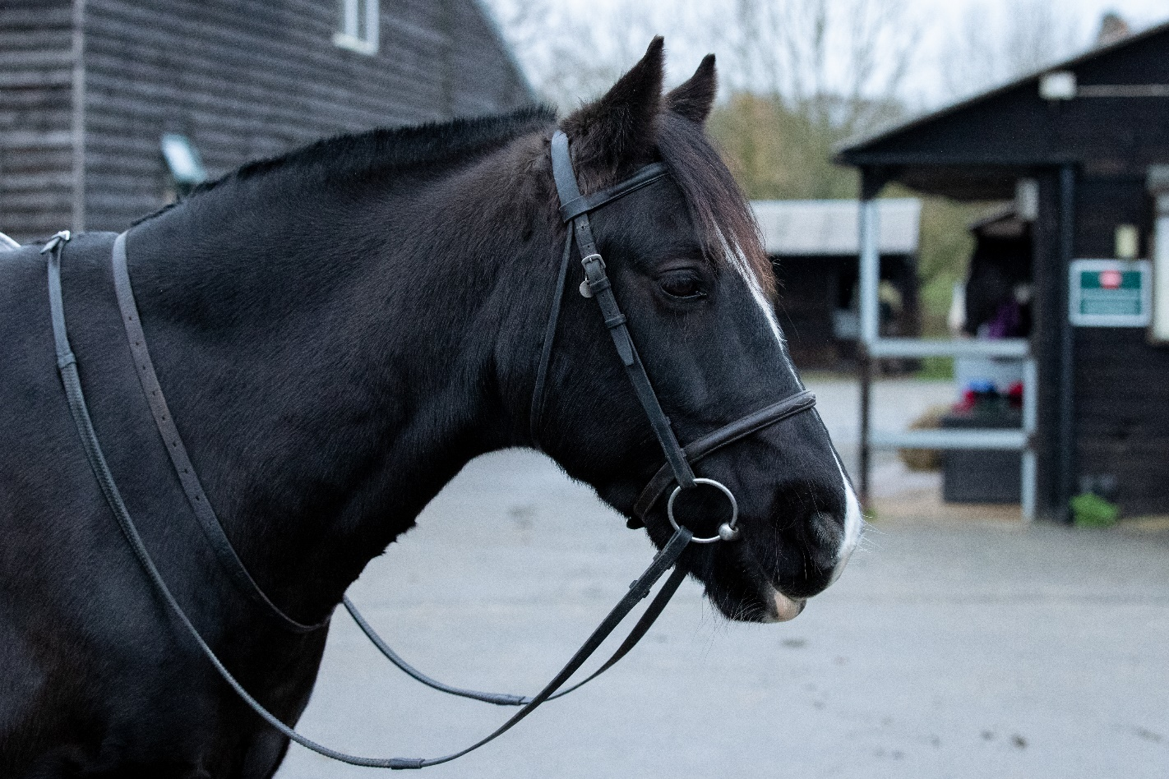
Parts of the bridle
Browband
Cavesson noseband
Reins
Cheekpieces
Bit
Notes:
Explain to the group that there are many types of bridle, the one pictured is a simple snaffle bridle with a cavesson noseband (and is the same picture as in the booklet)
Ask the group if they recognise any parts and talk briefly about what each part does
If possible take in a snaffle bridle so participants can see one

Slide 58
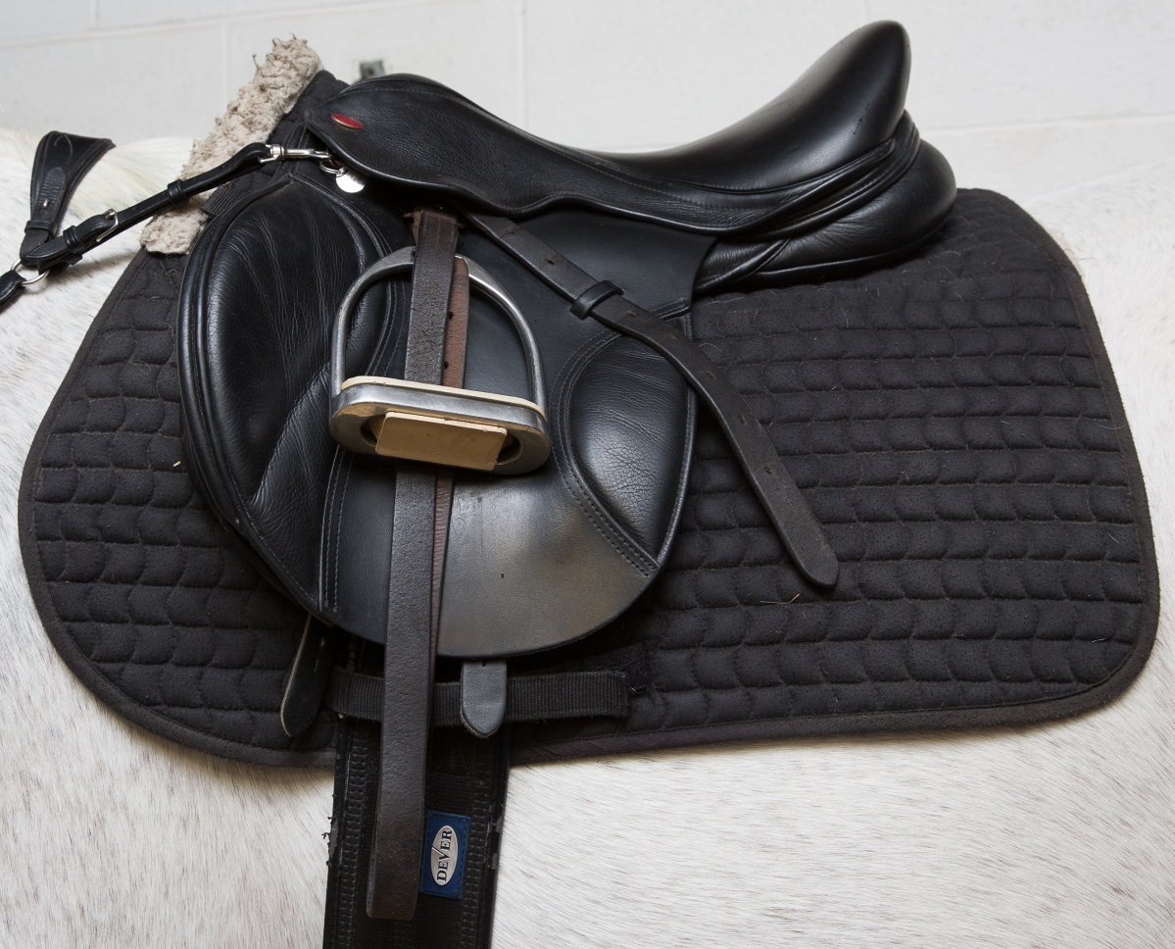
Parts of the saddle
Seat
Saddle cloth
Stirrup iron
Stirrup leather
Saddle flap
Girth
Notes:
Explain to the group that there are different types of saddle, the one pictured is the same picture as in the booklet
Ask the group if they recognise any parts
If possible take in a saddle so participants can see one
Although the saddle cloth isn’t a part of the saddle the label has been included for information! Explain the use of a saddle cloth and the various names they might hear.

Slide 59
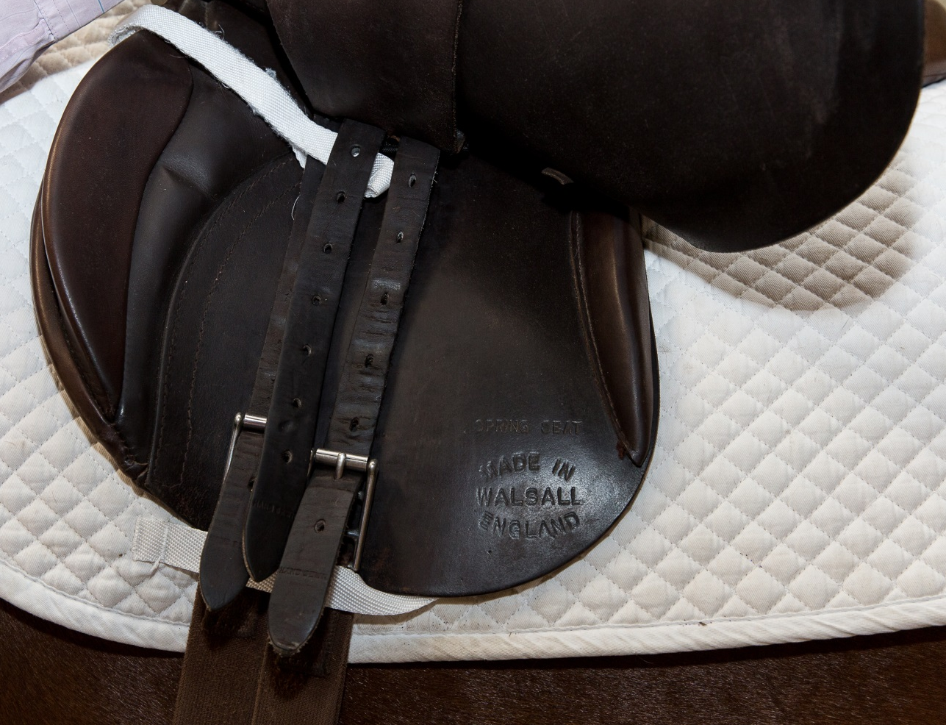
Parts of the saddle
Saddle flap
Knee roll
Thigh roll
Girth straps
Girth buckles
Notes:
Underside of the saddle

Slide 60
Quick quiz
List three parts of the bridle
List three parts of the saddle
Notes:
This quiz is very informal and is not designed to be a test. Answers can be written or verbal and there is space to write the answers in the booklet.
Any 3 parts of the bridle covered in the session
Any 3 parts of the saddle covered in the session

Slide 61
Congratulations you have completed Horse Knowledge part two

Slide 62
Notes:
This slide has been left blank for you to complete id required about the next steps for the group e.g. Bronze About the Horse Awards

